Slide 1
Advanced Persistent Threats (APT) & Zero Day Exploits
Securing the Future, One Ambassador at a Time.
www.iowacyberhub.org/ambassadors

Slide 2
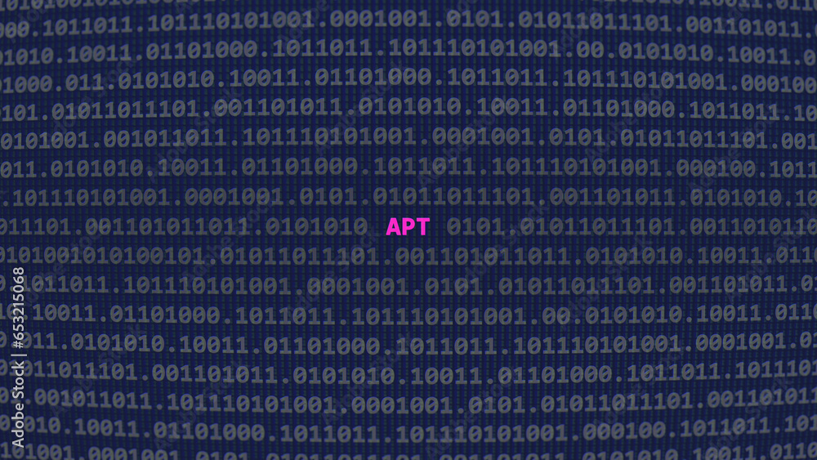
What is an APT?
APT is an extensive term that describes an attack campaign in which the intruder or intruders establish an illicit long-term presence in a network in order to obtain sensitive data or cause damage.
These attacks are highly research and particularly calculated by experienced cybercriminals or hackers.
Common Goals of an APT consist of total site takeover, database leak or deletion, steal sensitive information, and theft of property.
Common targets are governments and large companies.
Some APT are government funded cyberattacks.

Slide 3
How is APT Different from Malware?
APT are significantly more complex and carefully calculated. It takes lots of time and research in order to successfully pull of this kind of attack.
Not a hit and run attack, the goal is to infiltrate a system and stay to collect as much information as possible while remaining undetected.
Designed to be unnoticeable.
Manually executed by the hackers, rather than automatic such as viruses.
Goal is to Break into the entire network rather than just one specific part of it.
APT have 3 stages:
Infiltration
Expansion/Lateral Movement
Extraction

Slide 4
1: Infiltration
Infiltrate through web assets, network resources or authorized human users.
Commonly done with malicious uploads and/or social engineering.
Spear phishing very common.
Simultaneous DoS attacks sometimes used to be a distraction.
Could also be done with a Zero Day Attack.

Slide 5
What are Zero Day Exploits?
Cyber attack that exploits an unaddressed security flaw in the software, hardware or firmware.
“Zero Day” refers to the target having zero days to prepare or fix the security flaw.
These flaws or vulnerabilities have always existed in the software waiting to be discovered, hopefully by security professional before hackers.
Once discovered, even if by security professionals, the information spreads fast and it is a race to patch the issue before cyber criminals can find a way to abuse this vulnerability.
Often the hackers are quicker to find a solution, but once exploited the professional security members will know how to patch the issue only giving the hacker a small portion of time to do damage.
Common targets are:
Governments
Large companies and its members
Famous and political individuals

Slide 6
How to Prevent Zero Day Exploits?
Patch Management and Updating Systems:
Identifying and developing patches to the known security vulnerabilities. Often are short term solutions to problems that will be addressed in the next full software release.
Vulnerability Management:
Penetration testing to find flaws and identify them. Then deal with them in a timely manner.
Web Application Firewall (WAF)
A security device made to protect organizations by filtering and monitoring HTTP as well as HTTPS traffic from devices and the internet.

Slide 7
2: Lateral Movement/Expansion
Move to broaden presence after initial infiltration.
Move up the target organization to higher members and find more sensitive data.
Explore and map the entire network.
Crack passwords.
Install malware.
Create a connection to control network from a remote server.
Depending on goal: Sabotage company product lines, take down an organization, delete databases or disrupt network communication.

Slide 8
3: Extraction
Steal and move data to secure location and extract without being detected.
Common to weaken defense or launch DoS attacks to create a distraction known as white noise.
Potentially encrypt and compress data for easier extraction.
In certain cases, remove evidence of attack and leave without a single trace.

Slide 9
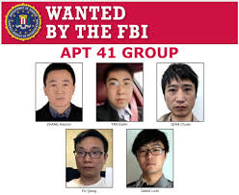
Real World Example: APT41 (Wicked Panda)
Notorious Chinese based ATP group.
Allegedly tied to the Chinese Communist Party.
Attacks for espionage and financial gain.
Believed to be responsible for hacking healthcare supply chains, stealing information from biotech firms, and theft of Covid-19 payment plans in America.
See more info here:
Credit: https://www.zdnet.com/article/us-charges-five-hackers-part-of-chinese-state-sponsored-group-apt41/

Slide 10
Detecting ATP Attacks
Targets for ATP attacks are generally high value user accounts with access to sensitive information.
Look for multiple log in’s to accounts, often at night due to time zone that differ if the hacker is in a different region of the world.
Look for backdoor trojans for re entry into a system.
Data moved to an unusual spot not done by the authenticated user.
Emails from unknown people with Microsoft word docs or adobe pdf, these often contain malicious software (Aka spear phishing).

Slide 11
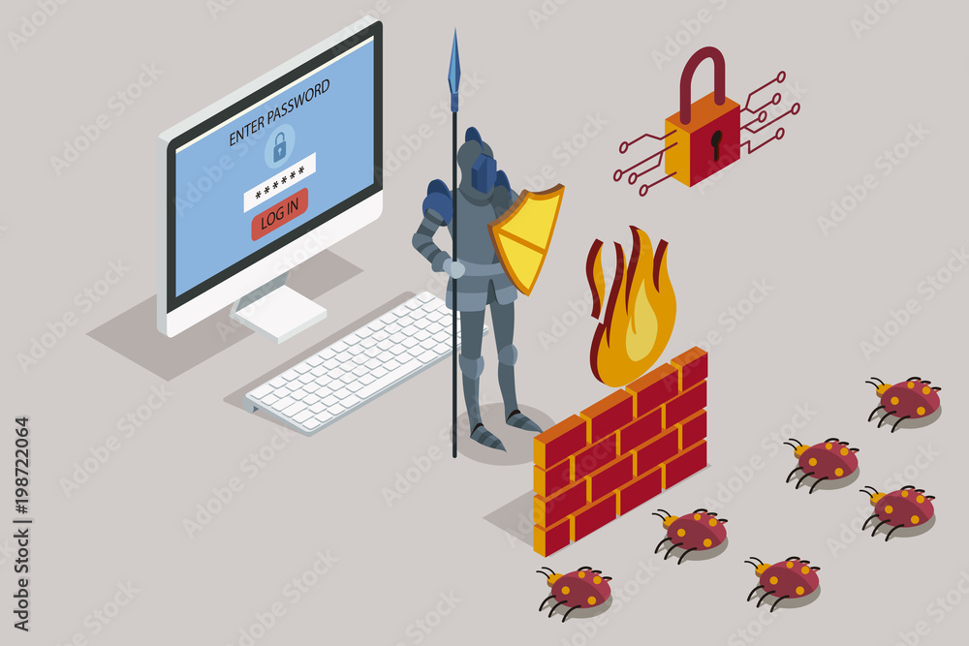
Preventing ATP Attacks
Keep software updated to remove weaknesses that have been discovered.
Monitor network traffic.
Use web application firewalls.
Implement strict access to sensitive data.
Conduct penetration testing to identify weaknesses and vulnerabilities.
Invest in threat intelligence to respond quickly to a attack.

Slide 12
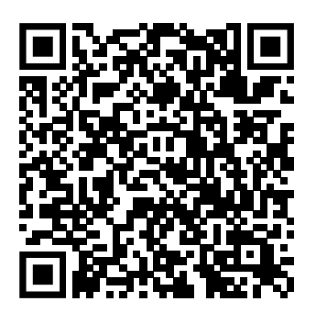
Thank You for Your Time! Please fill out the survey on the QR code!
Citations
https://www.imperva.com/learn/application-security/apt-advanced-persistent-threat/
https://www.ibm.com/topics/advanced-persistent-threats
https://www.ibm.com/topics/zero-day
https://www.imperva.com/learn/application-security/zero-day-exploit/
https://www.crowdstrike.com/cybersecurity-101/zero-day-exploit/
https://www.fbi.gov/wanted/cyber/apt-41-group
https://stock.adobe.com/

