Slide 1
Malware Types
Securing the Future, One Ambassador at a Time.
www.iowacyberhub.org/ambassadors

Slide 2
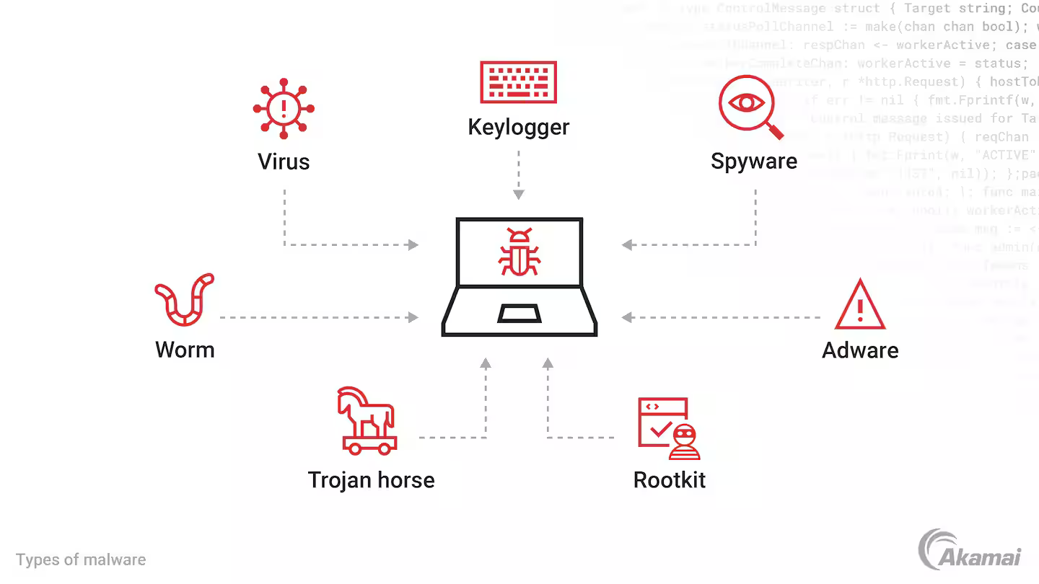
What is Malware?
Malware is defined as a software that is used to cause harm to the device, user, or network.
Malware is short for Malicious software
Used by cyber criminals or “Hackers”
Common types of Malware include: Viruses, Worms, Trojans, Spyware, Adware, Fileless malware, and Ransomware
Malware can even be installed on mobile devices

Slide 3
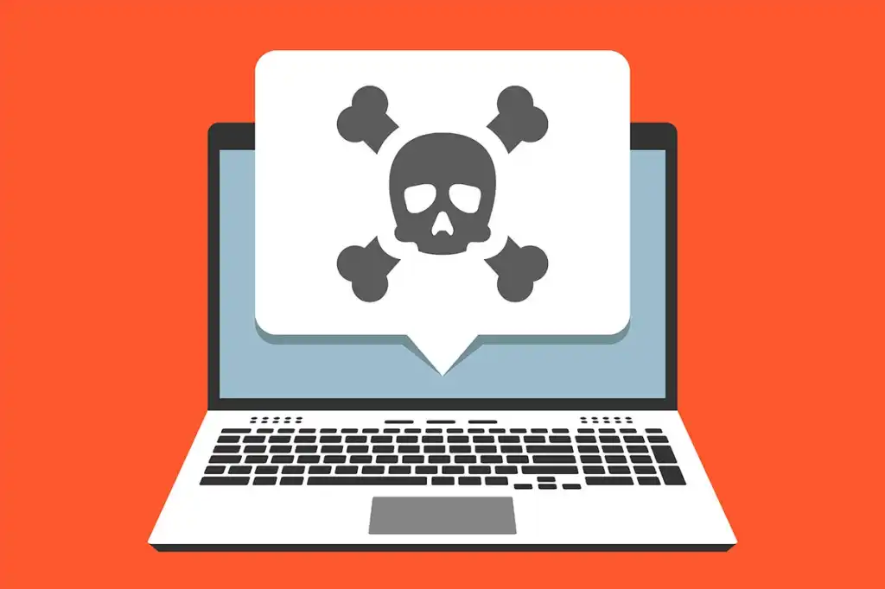
How do you get it?
Malware can be installed on a computer through many different tactics
Some common ways are links in emails, visiting sketchy websites, downloading files from non reputable sources, plugging in an infected USB
Can be hidden in plain sight on photo, video, .exe files, word documents and more
Credit: https://www.csoonline.com/article/548570/security-your-quick-guide-to-malware-types.html

Slide 4
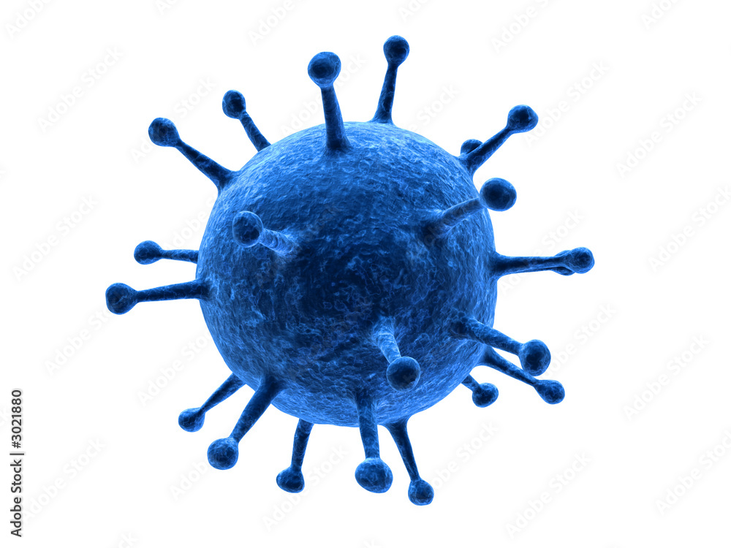
Viruses
Viruses are a form of malware that is usually found in a attachment on emails
Once opened the device is infected
Viruses can self replicate, meaning they can add themselves to other applications on the users computer and send emails to others using the users information
Often disrupt the operating systems ability to perform, sometimes crashing the device

Slide 5
Worms
Ability to self replicate
Spreads from computer to computer on a network connection
Needs no user interaction to function
Similar to a virus, disrupts operating systems ability to perform
Can cause data loss

Slide 6
Trojans
Hides in plain sight as harmless applications or file
Usually trick users to download them, and once opened the computer is infiltrated
Ability to steal personal information, crash devices, spy on activities or even launch an attack
Not self replicable

Slide 7
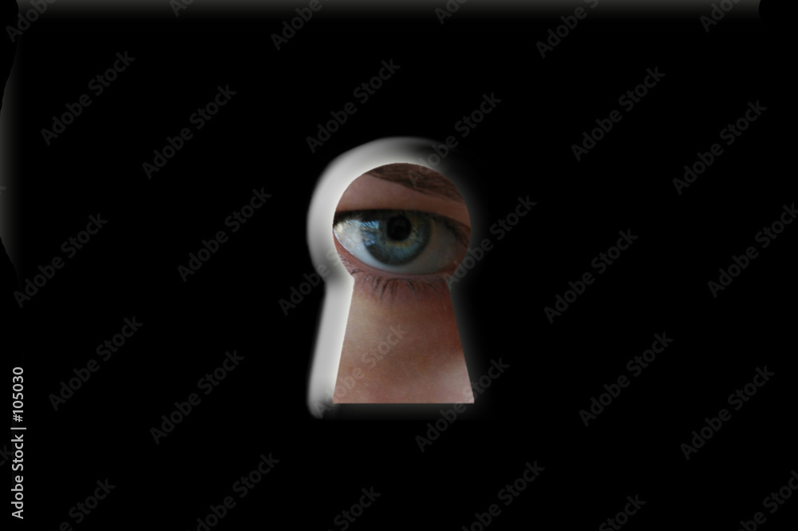
Spyware
Runs secretly on a device and reports back to a remote user
Often used to steal financial/personal information
Many Federal agencies use it but available for anyone to purchase
Common to get from email links/attachments or connecting to a infected network
Example: Keylogger which tracks the keys entered to obtain passwords

Slide 8
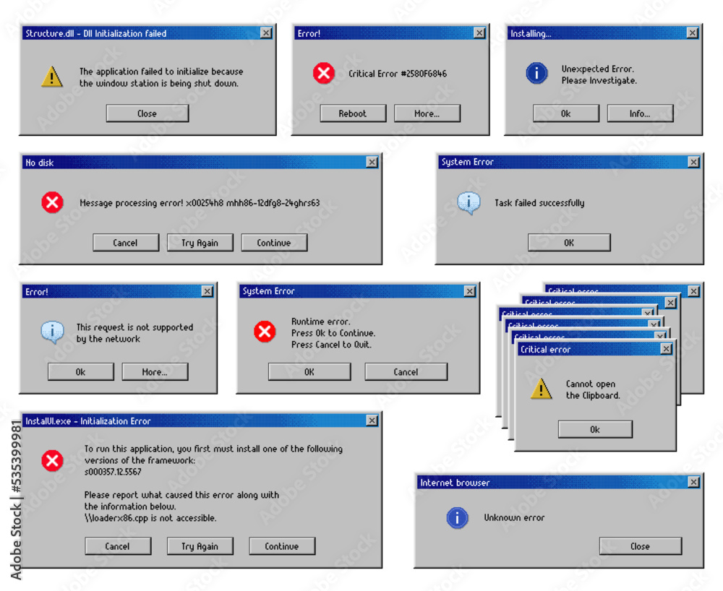
Adware
Used to push unwanted ads or popup windows
Usually is in exchange for another service such as using a software service without paying
Not always dangerous
Tracks browsing/download history in order to display adds that attend to the users interest

Slide 9
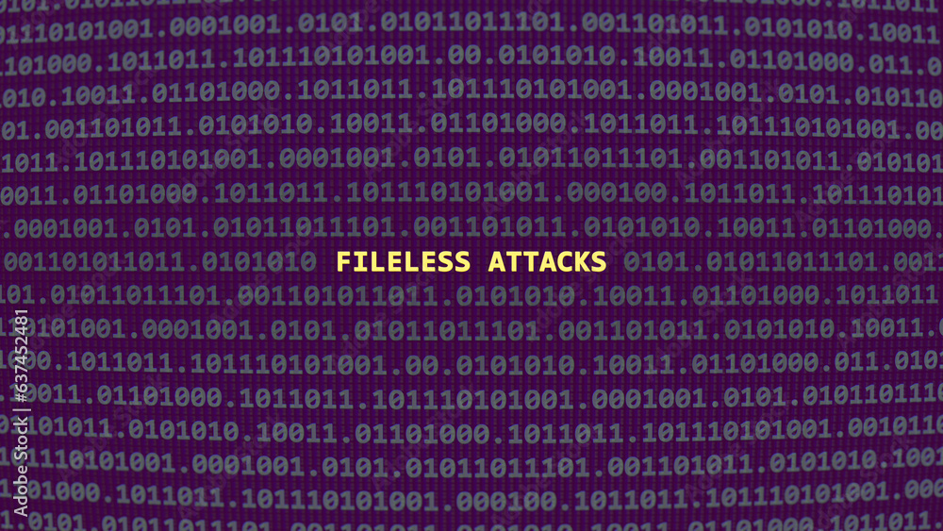
Fileless Malware
Rely on a computer's memory (RAM) rather than files on the hard drive
Harder to detect due to the lack of presence in the hard drive
Disappears when a computer is rebooted so it's more difficult to do forensics
Hides in legit programs but will use more RAM than the legitimate program should

Slide 10
Ransomware
Very popular due to the profitability
Installs itself onto a victim and encrypts files requesting money in return for the key to get the files back
Commonly from phishing scams
Not self replicable

Slide 11
Methods of Detection
Slow PC
Browsers redirecting to tabs the user didn’t open
Infection warnings asking the user to make a purchase to protect themselves
Frequent popup adds

Slide 12
How to Remove Malware
Difficult and depends on the scenario and type of malware
Most common way is a anti-virus program that scans and deletes found malware on the hard drive
Only use anti-virus software from trusted companies as many cyber criminals hide malware in a “anti-virus” software that is not legit

Slide 13
How to Stay Protected?
Keep operating systems updated, many cyber criminals prey on old software with unpatched holes that leave a victim vulnerable
Don’t click popup links or open random email attachments
Only install apps that are needed
Don’t leave devices unattended
Keep an eye out for files that shouldn’t be installed
Stay away from unknown links and only use trusted websites
Only download apps from the official app store
Run regular scans on your computer from trusted security software
Check bank and credit card statements regularly

Slide 14
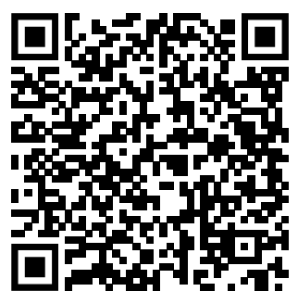
Citations
Thank You for Your Time!
Please fill out the survey on the QR code!
https://www.mcafee.com/en-us/antivirus/malware.html
https://www.cisco.com/site/us/en/learn/topics/security/what-is-malware.html
https://www.techtarget.com/searchsecurity/definition/malware
https://stock.adobe.com/

