Slide 1
Mobile and IoT Security
Securing the Future, One Ambassador at a Time.
www.iowacyberhub.org/ambassadors

Slide 2
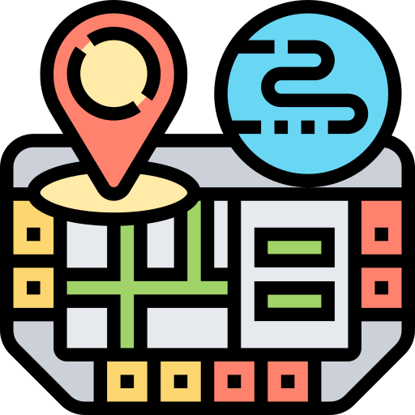
What are Mobile Devices?
Portable, electronic, and designed to be easily carried on the go. Typically have wireless capabilities, allowing connection to WiFi, Bluetooth, and cellular networks. Makes it possible to use without being tethered to a fixed location.
Most common is a smartphone, something most people have nowadays. Used for instant messaging, phone calls, emails, finances, etc. on the go.
Other common mobile device examples include:
https://www.flaticon.com/free-icons/tablet
https://www.flaticon.com/free-icons/electronic-book
https://www.flaticon.com/free-icons/watch
https://www.flaticon.com/free-icons/headset
https://www.flaticon.com/free-icons/map
https://www.flaticon.com/free-icons/photography
Tablets
E-Readers
Smartwatches
Headsets
GPS
Cameras
Click on the name to learn more!
Icons created by Eucalyp - Flaticon
Notes:
This is a basic slide describing what mobile devices are and some examples. For more in-depth information on each device, there is a link to a slide connected to the device name. These slides are for more inexperienced learners, who may not understand why these are considered mobile devices or who may not be familiar with them.

Slide 3
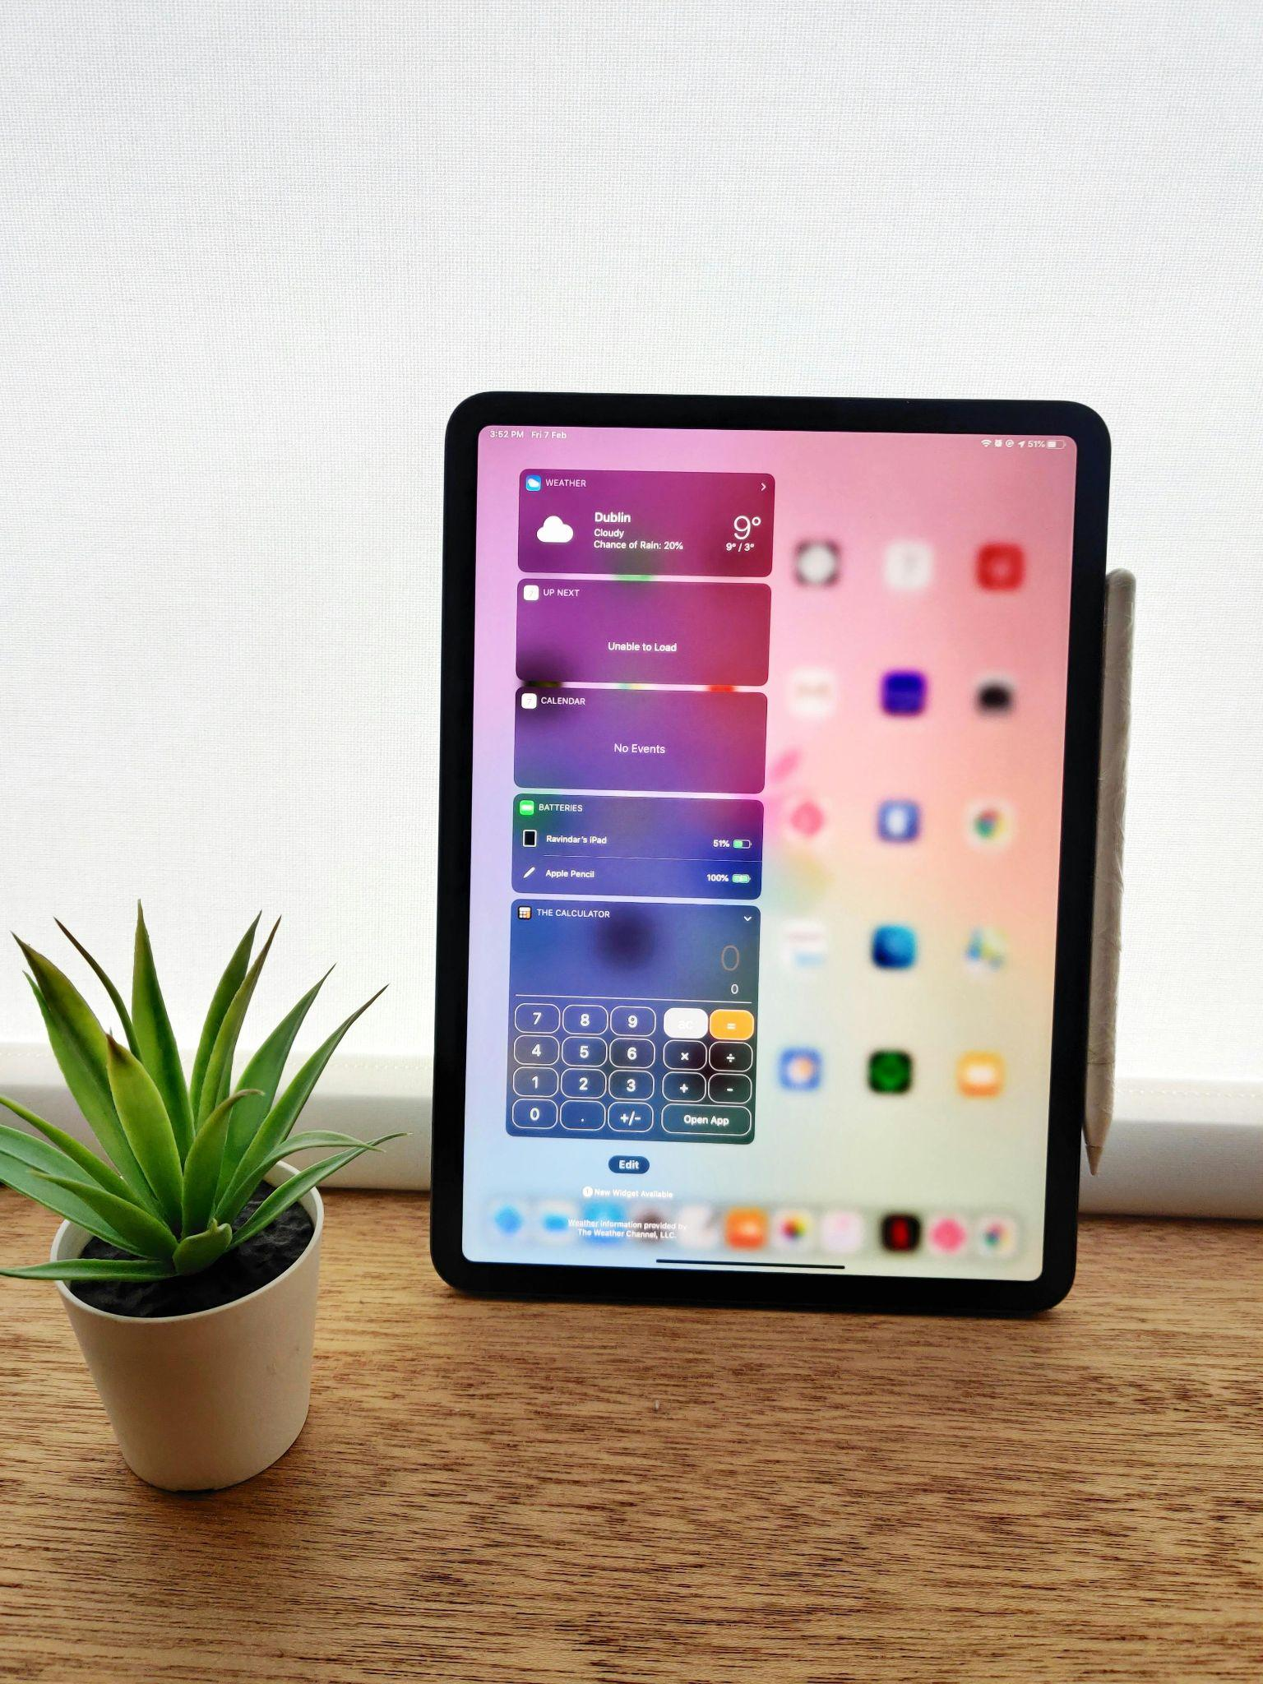
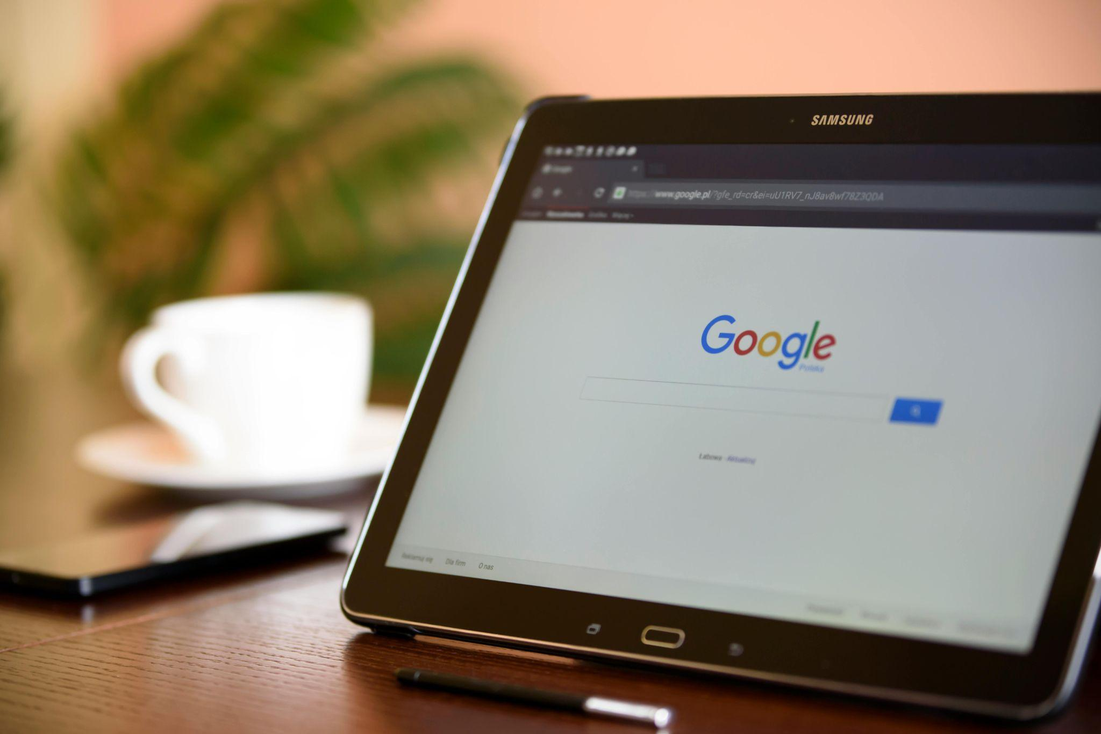
Tablets
Slightly bigger than smartphones
Can have similar uses to smartphones but are often more limited in useability
Found to be used chiefly by younger and older generations
Popular ones include Apple iPad, Samsung Galaxy Tablet, Amazon Fire, Microsoft Surface Go, etc.
Photo by Ravindar Negi: https://www.pexels.com/photo/black-ipad-on-brown-wooden-table-3785868/
Explore Other Mobile Devices
Photo by PhotoMIX Company: https://www.pexels.com/photo/black-samsung-tablet-on-google-page-106341/

Slide 4
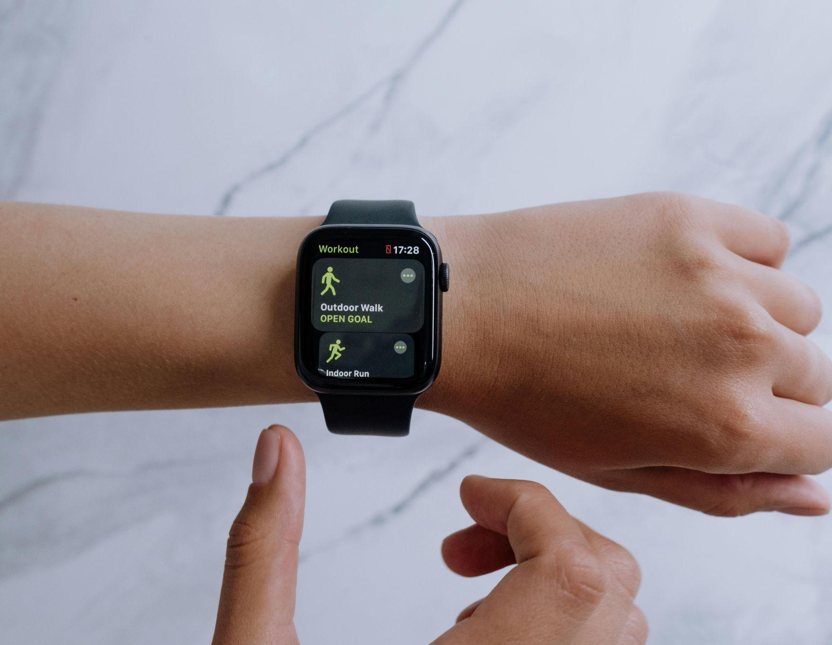
Smartwatches
Mainly used for reading active statistics
Can be connected to a smartphone to handle payment transactions, phone notifications, and calls
Examples include Apple Watches, FitBits, Samsung Galaxy Watches, Amazfits, and Google Pixels.
Explore Other Mobile Devices
Photo by cottonbro studio: https://www.pexels.com/photo/person-wearing-black-smartwatch-5081922/
Photo by Ivan Samkov: https://www.pexels.com/photo/person-in-white-long-sleeve-shirt-wearing-smartwatch-7621138/
Photo by MOHI SYED: https://www.pexels.com/photo/black-samsung-gear-displaying-05-55-on-white-surface-51011/

Slide 5
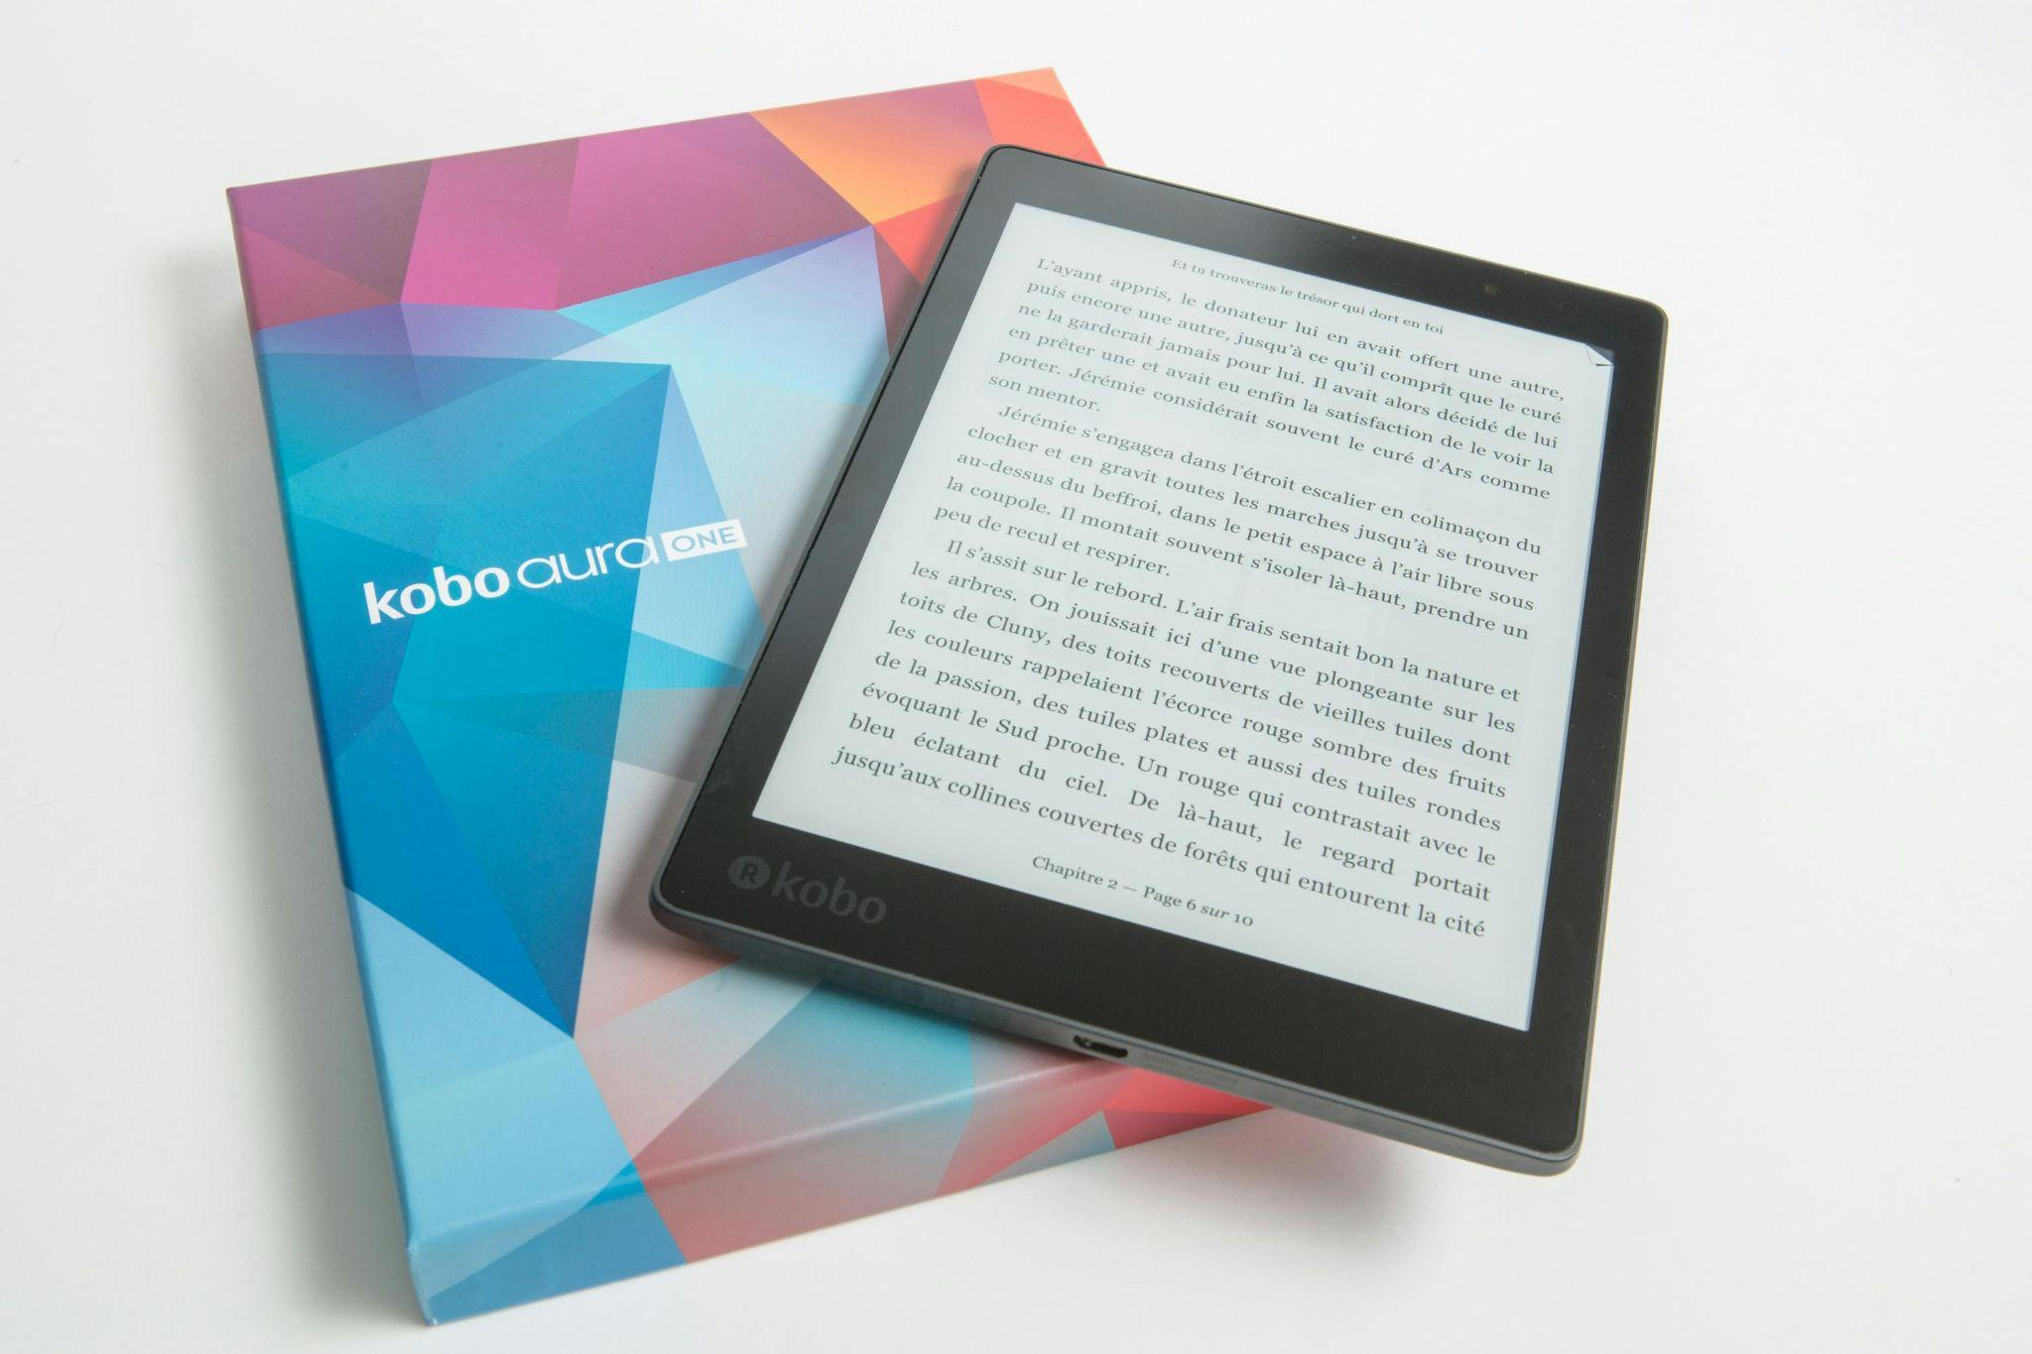
E-Readers
Small libraries with access to e-books, and other online reading material
Examples include Amazon Kindle, Kobo E-Readers, NOOKs, and Onyx Boox
Explore Other Mobile Devices
Photo by Perfecto Capucine: https://www.pexels.com/photo/black-kobo-aura-one-tablet-with-box-1475296/

Slide 6
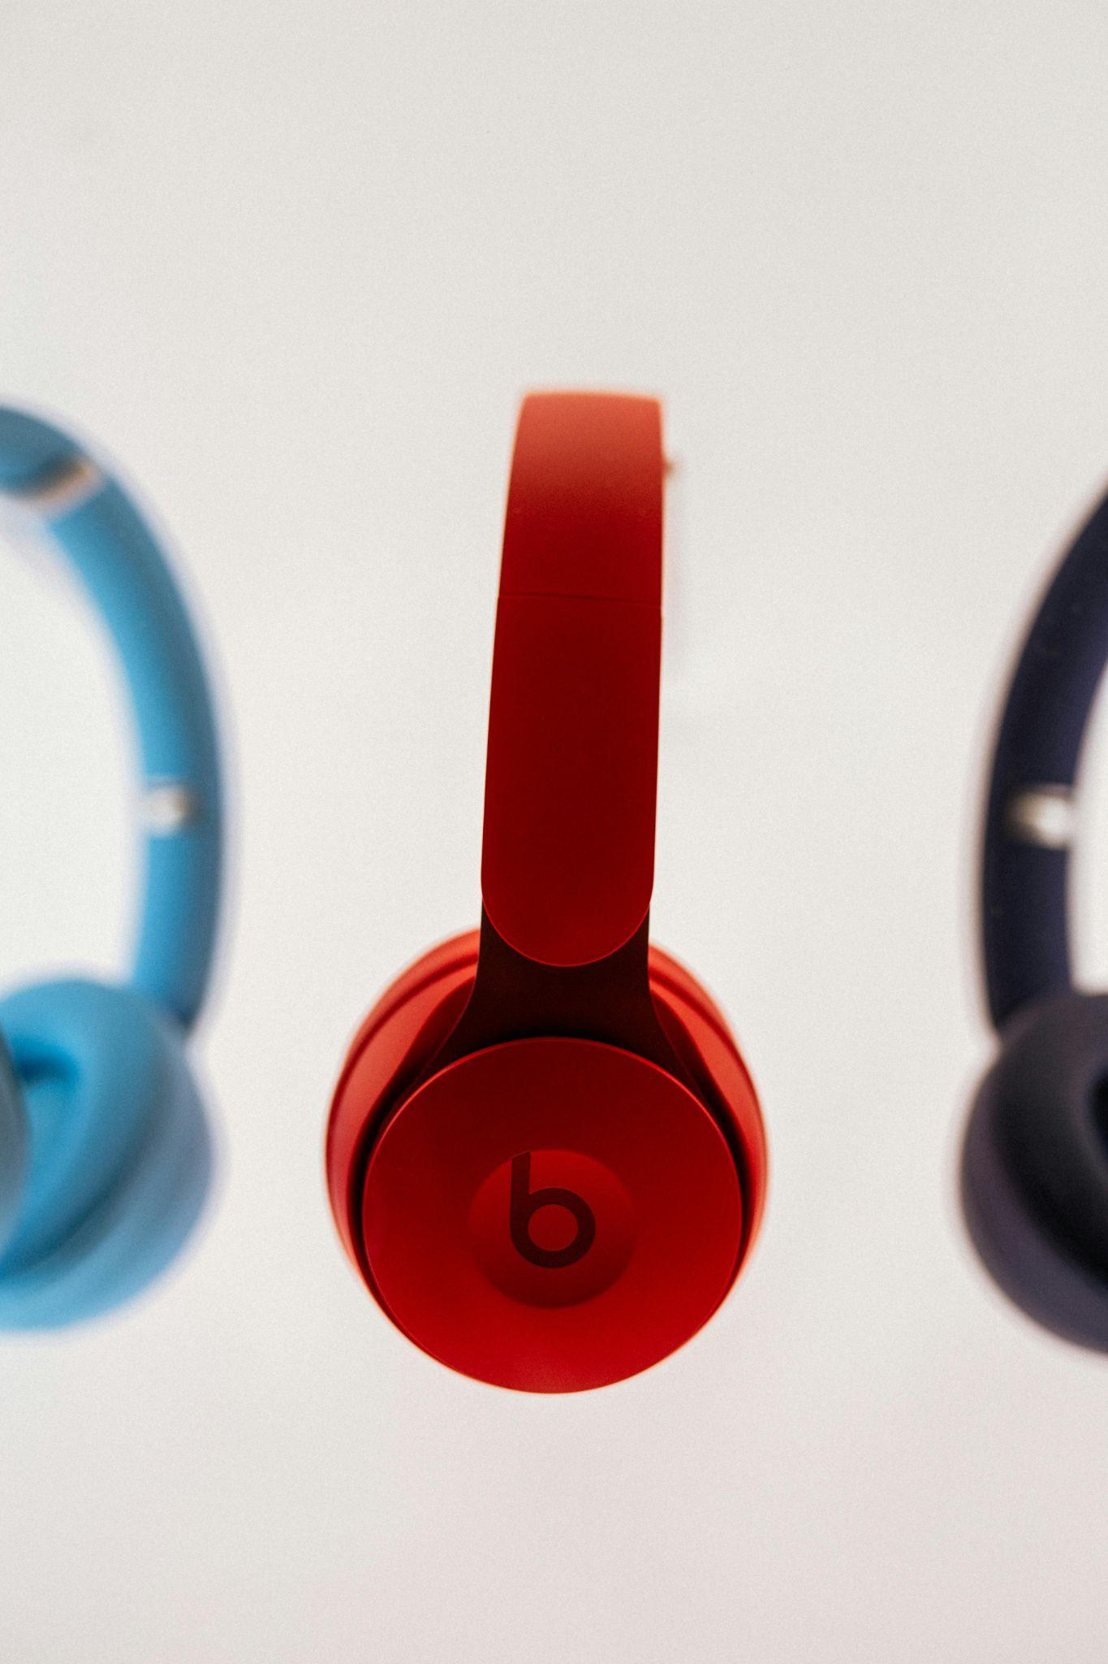
Headsets
Bluetooth connects Headphones or earbuds to other devices
Often wireless and may or may not have a wired option
Popular Brands: Apple / Beats, Sony, Samsung, Logitech, Steel Series, BlueParrot, Skullcandy
Explore Other Mobile Devices
Photo by Dina Nasyrova: https://www.pexels.com/photo/white-apple-airpods-on-white-table-3825517/
Photo by Kevin B: https://www.pexels.com/photo/choice-of-headphones-16729742/

Slide 7
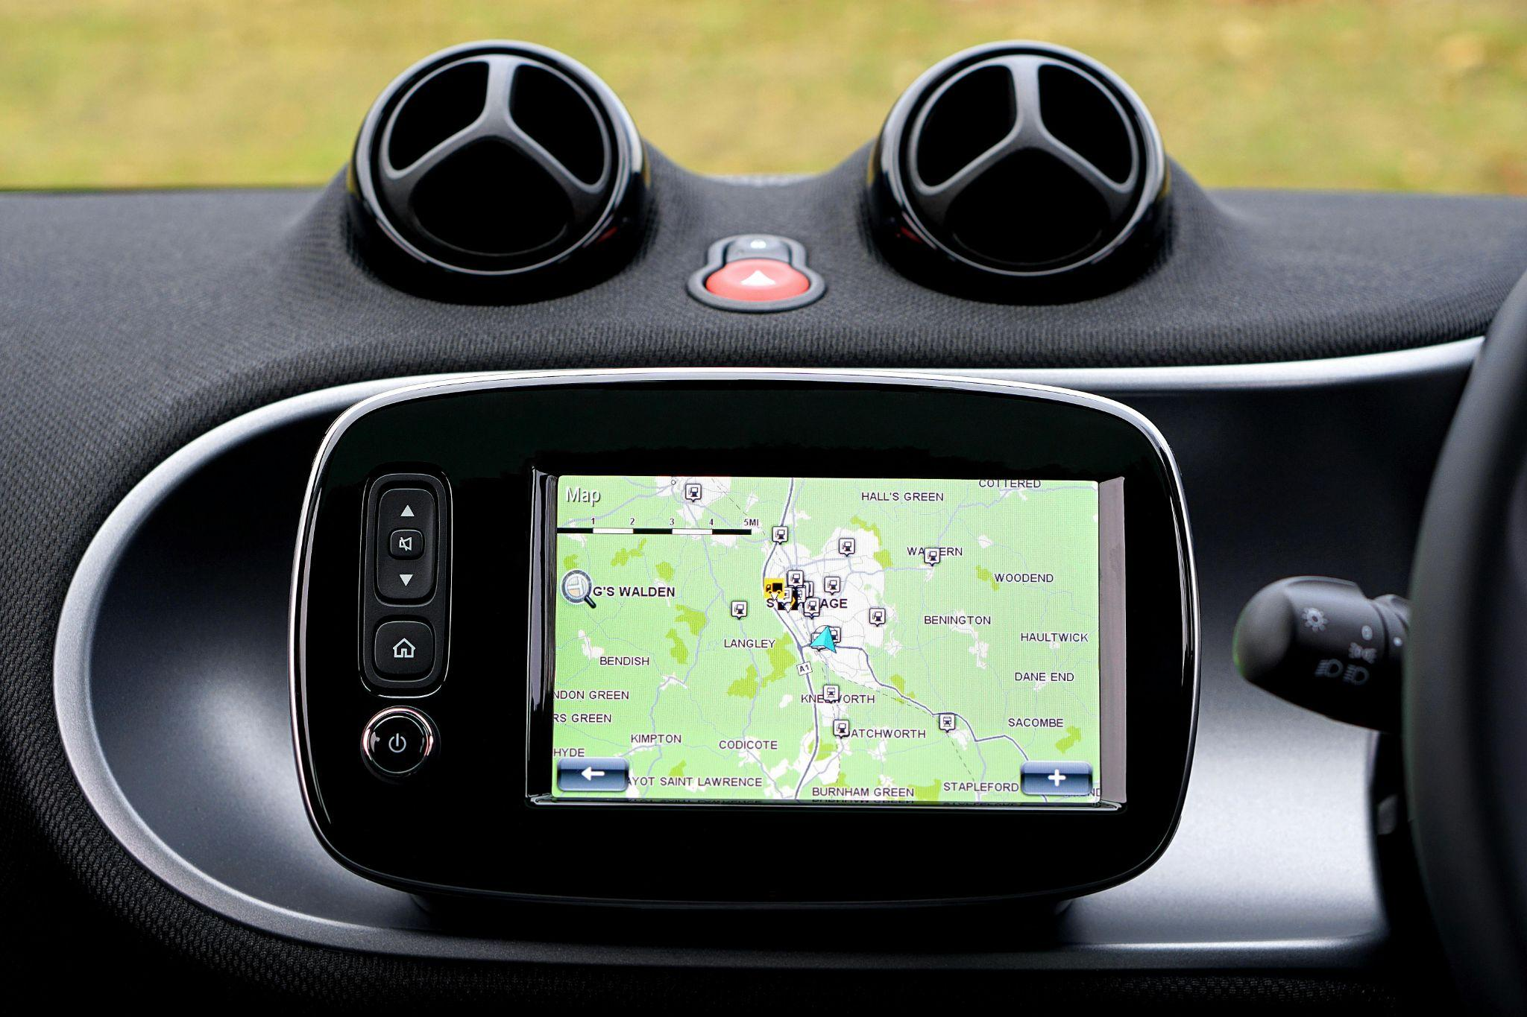
GPS
Directional devices
Can be included on a smartphone or stand-alone
Read data from maps and locations to help users navigate to a desired location.
Explore Other Mobile Devices
Photo by Mike Bird: https://www.pexels.com/photo/turned-on-black-gps-monitor-244822/
Photo by Gaspar Zaldo: https://www.pexels.com/photo/man-touching-an-electronic-device-in-a-boat-11315278/

Slide 8
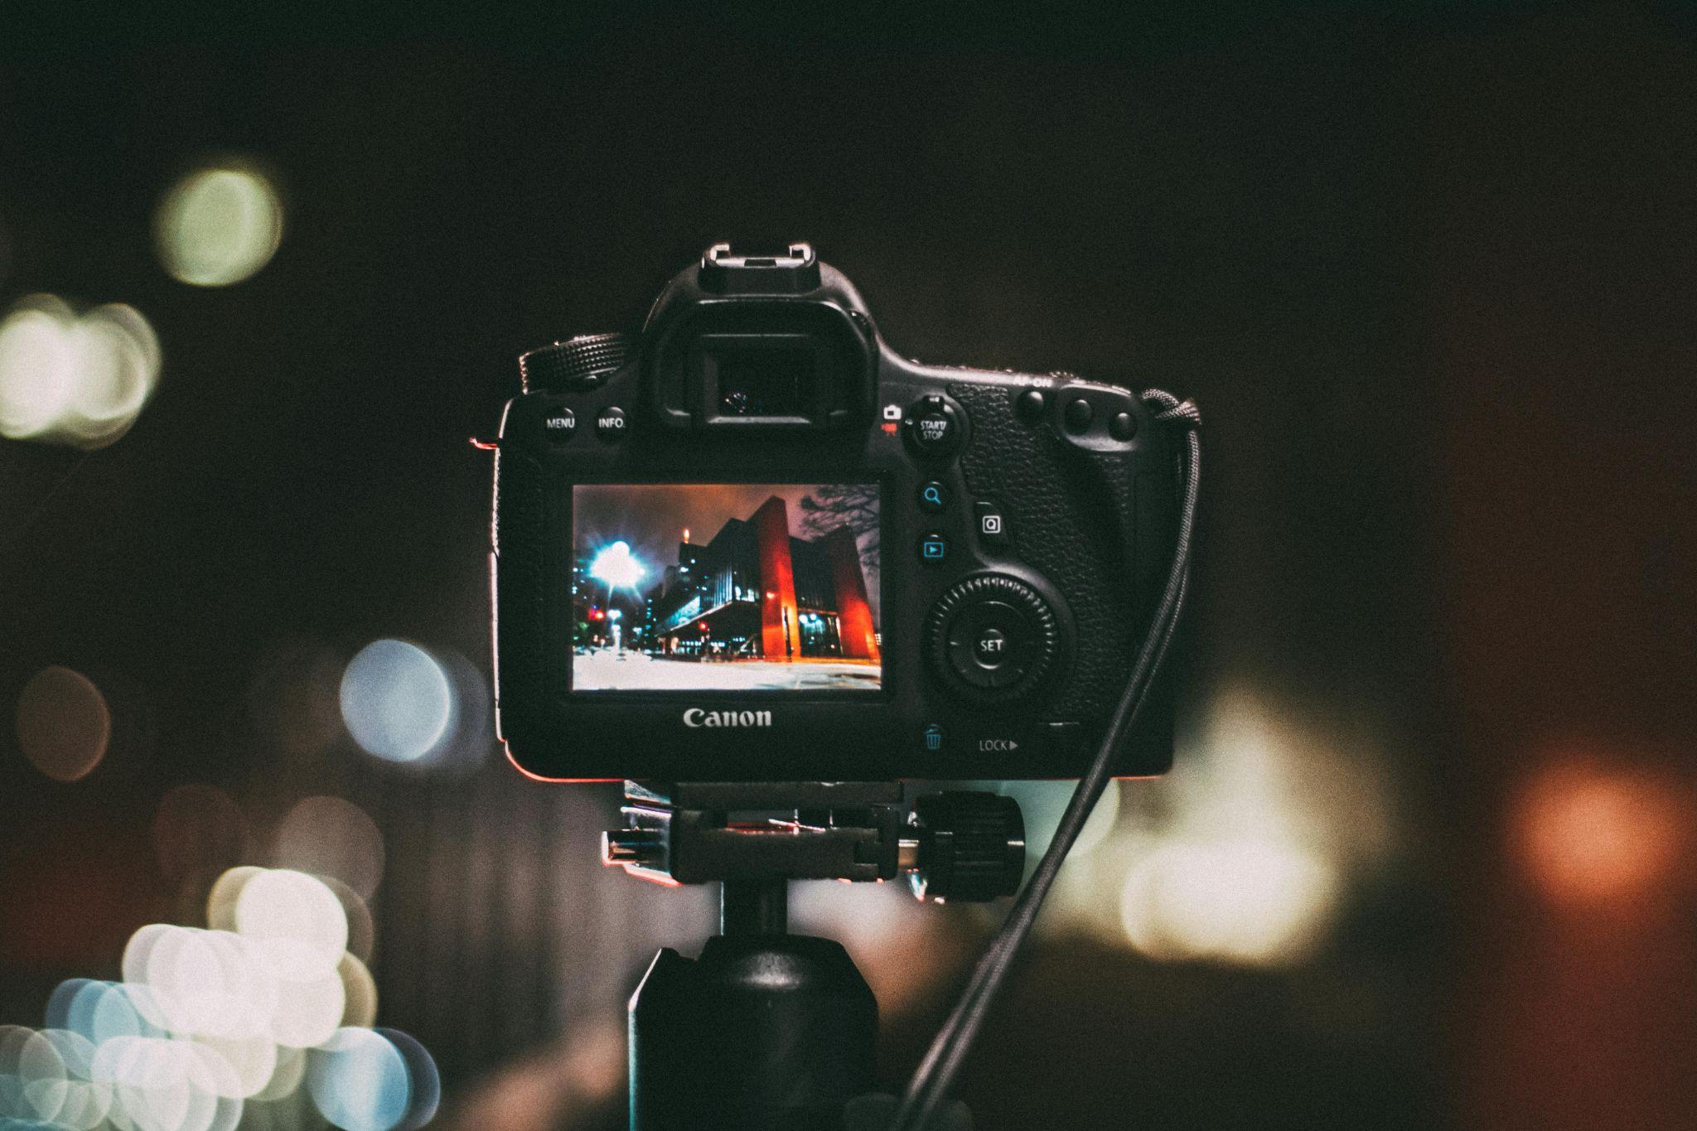
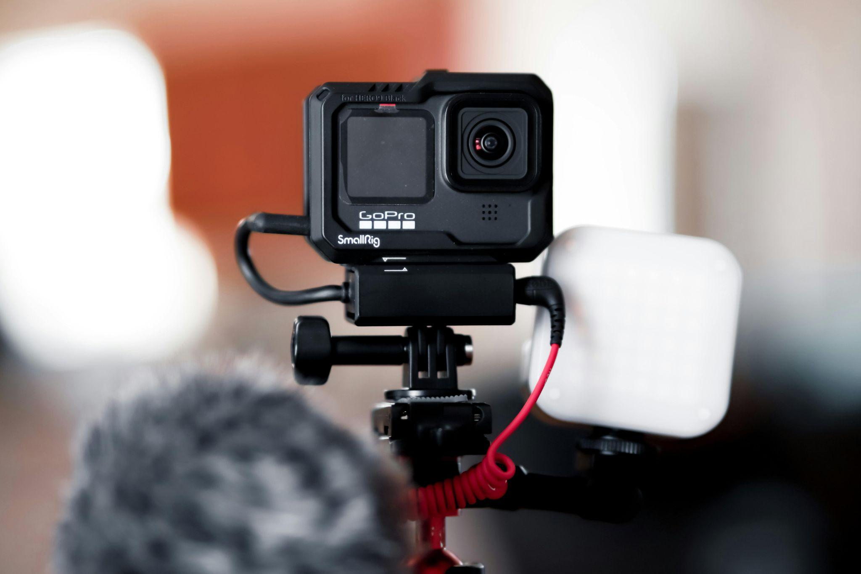
Cameras
Capture images
Can be an addition to smartphones, watches, tablets, or be stand alone
Can save photos immediately to cloud or on device itself
Explore Other Mobile Devices
Photo by Kaique Rocha: https://www.pexels.com/photo/selective-focus-photography-of-black-canon-camera-displaying-photo-of-red-and-black-building-243757/
Photo by Enson Renton: https://www.pexels.com/photo/go-pro-on-black-tripod-12630462/

Slide 9
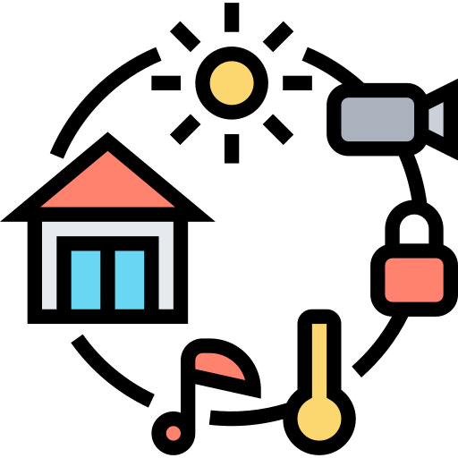
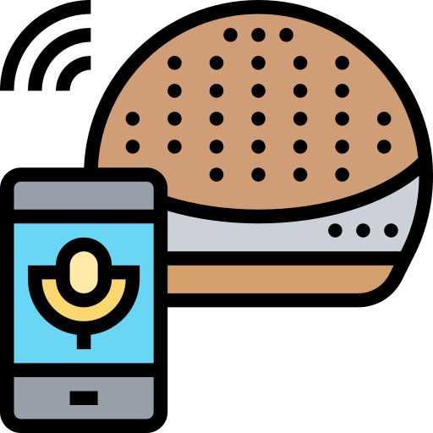
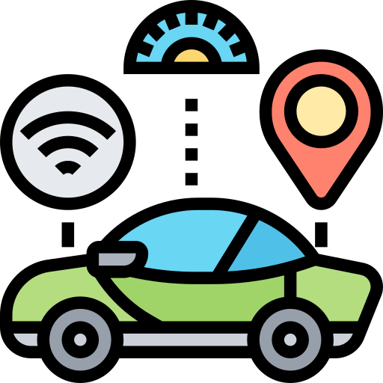
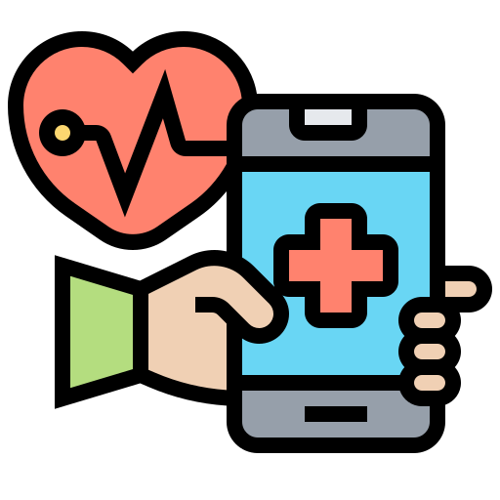
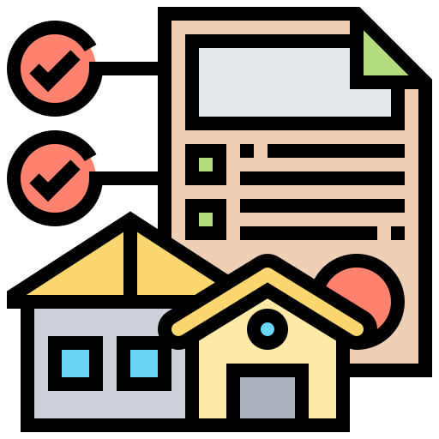
What are IoT Devices?
IoT = Internet of Things
Physical objects embedded with sensors, software, and other technologies that enable them to connect to the internet and exchange data with other devices and systems
Can range from everyday objects, such as household appliances, thermostats, and wearable devices, to industrial machinery and infrastructure components
The interconnectedness of IoT devices allows for remote monitoring, control, and automation of various processes, leading to increased efficiency, convenience, and insights into the physical world
https://www.flaticon.com/free-icons/smart-home
https://www.flaticon.com/free-icons/smart-speaker
https://www.flaticon.com/free-icons/driverless-car
https://www.flaticon.com/free-icons/healthcare
https://www.flaticon.com/free-icons/property
Smart Home
Speaker
Vehicles
Health Devices
Building Monitors
Click on the name to learn more!
Icons created by Eucalyp - Flaticon

Slide 10
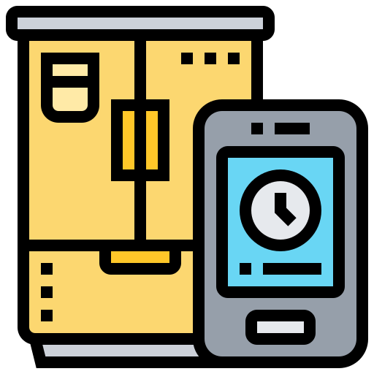
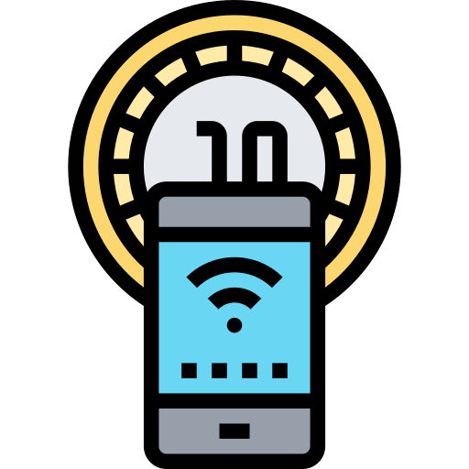
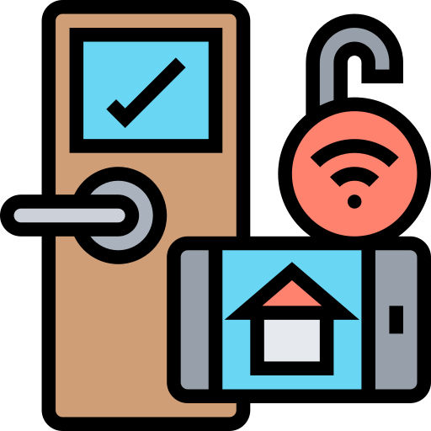
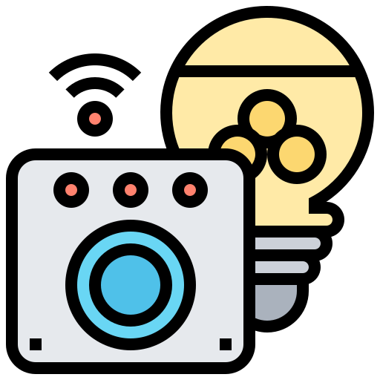
Smart Home
Light operators, thermostats, and air conditioning to fridges, stoves, and security systems
Add technology to the home, allowing access to devices and appliances through another device like smartphones
Or an upgraded version of the appliance that accesses data from the internet and surroundings
Can also include doorbells like the Ring Doorbell, which records when someone is at the door and acts as a security cam
Explore Other IoT Devices
https://www.flaticon.com/free-icons/fridge
https://www.flaticon.com/free-icons/smarthome
https://www.flaticon.com/free-icons/smart-control
https://www.flaticon.com/free-icons/surveillance
https://www.flaticon.com/free-icons/internet-of-things
Icons created by Eucalyp - Flaticon

Slide 11
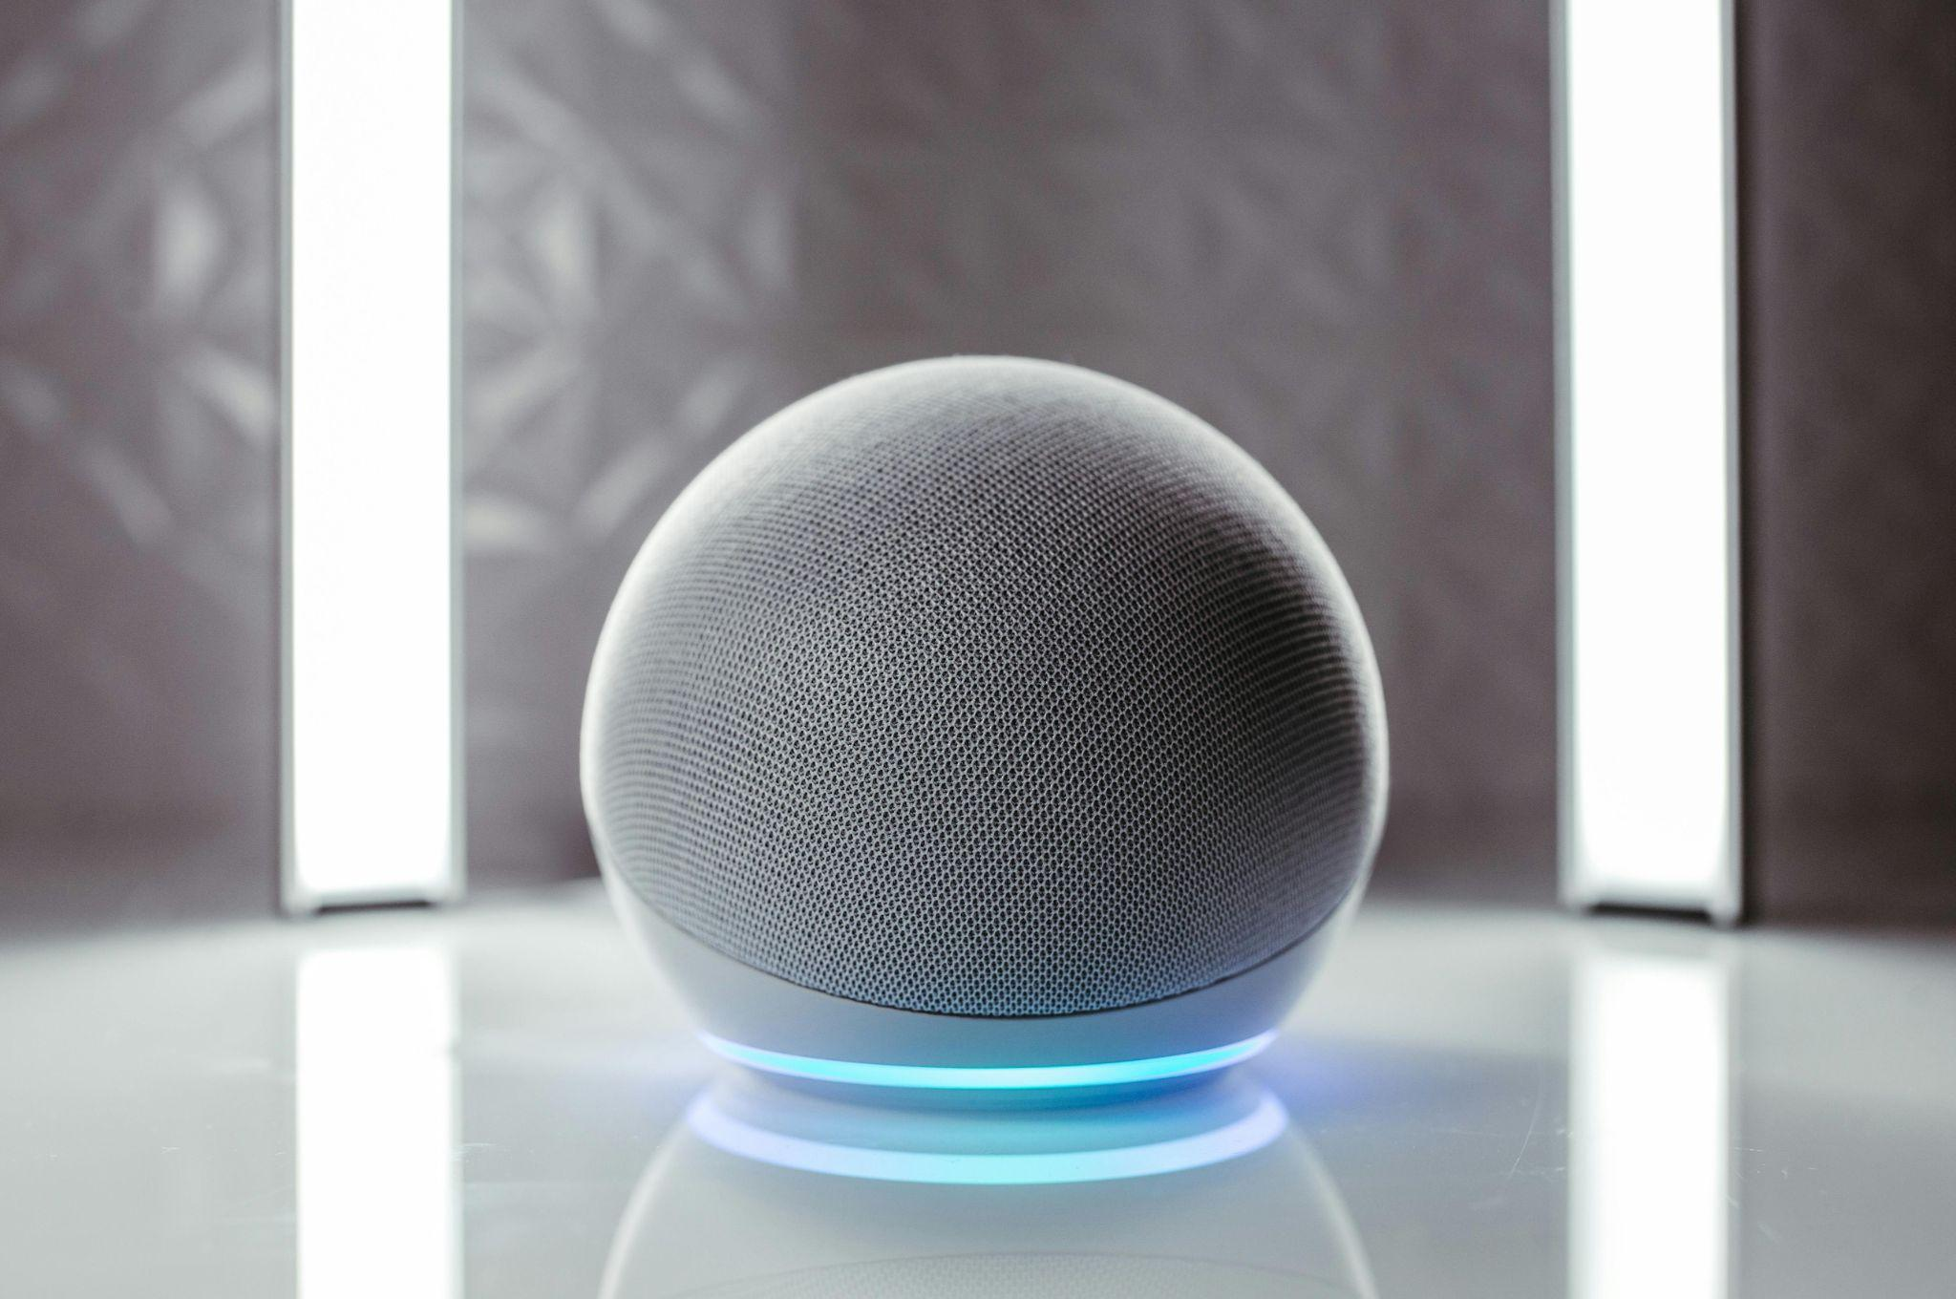
Speakers
Small Bluetooth devices or larger ones for TVs
Connected via Bluetooth and play sound
Some, like Alexa or Google Assistant, access user data from their phone or internet data and utilize AI
Explore Other IoT Devices
Photo by Jonathan Borba: https://www.pexels.com/photo/close-up-photo-of-gray-round-speaker-14309809/

Slide 12
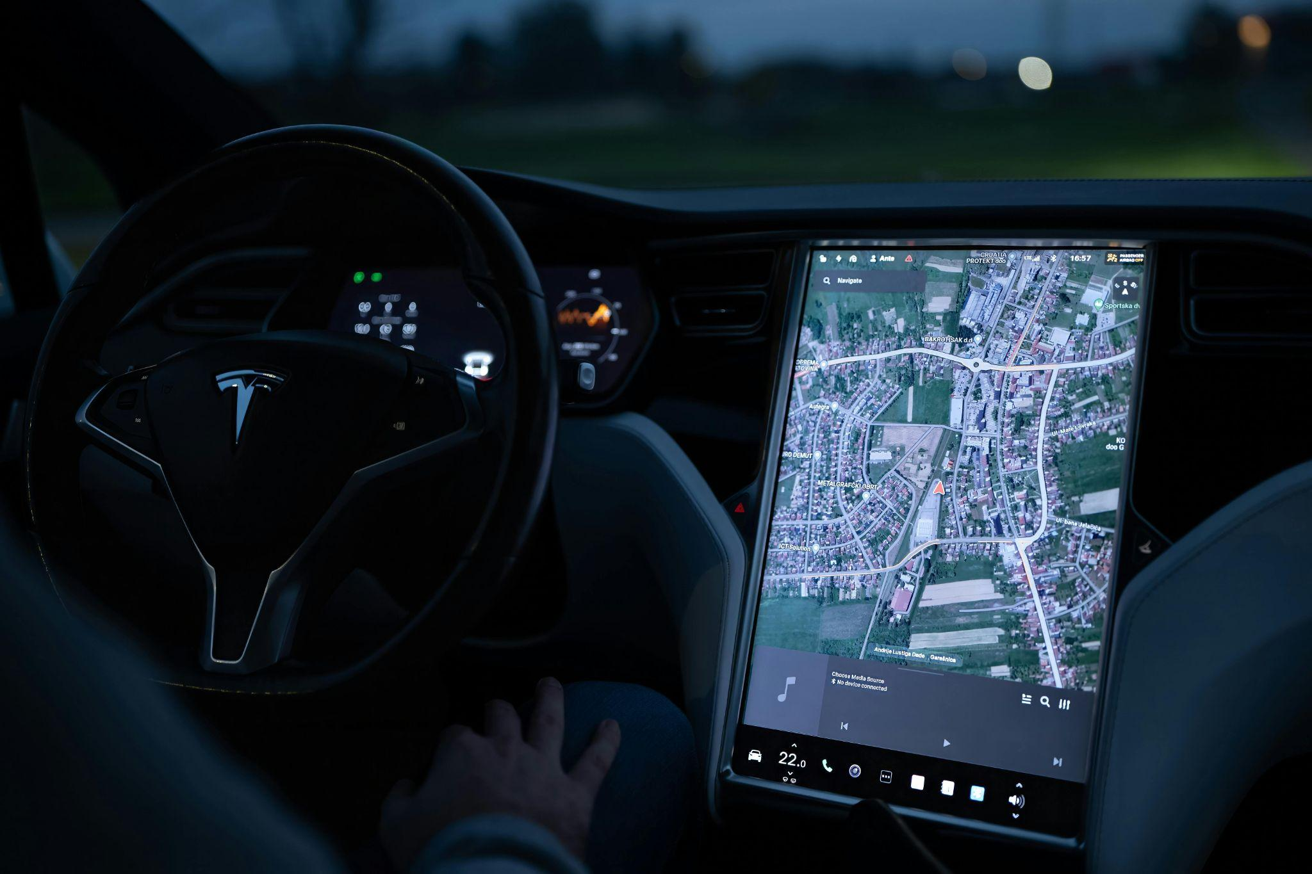
Vehicles
Either self-driving or cars with sensors telling the user if they are near another object
Cars that have smart devices within them to connect to a phone, use a GPS, or access other forms of the internet
Can also include tractors with a full camera view of the field they are working on
Explore Other IoT Devices
Photo by Vladimir Srajber: https://www.pexels.com/photo/view-of-a-tablet-showing-the-map-in-a-tesla-18977344/

Slide 13
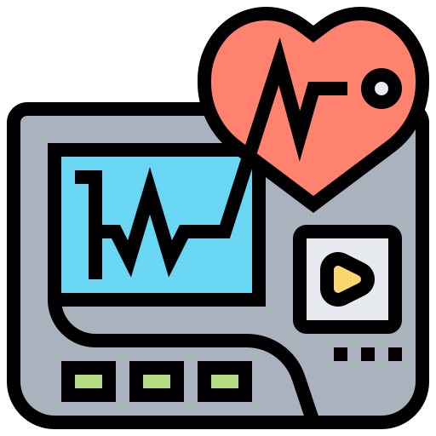
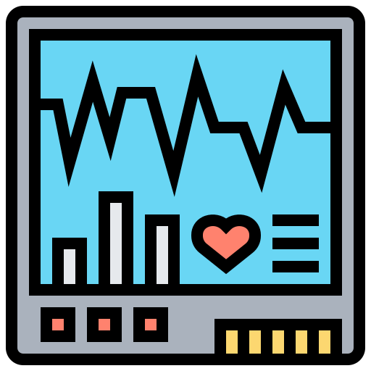
Health Devices
Includes glucose monitors and heart monitors
Used to read human vitals and health
Explore Other IoT Devices
https://www.flaticon.com/free-icons/heart-rate-monitor
https://www.flaticon.com/free-icons/ekg

Slide 14
Building Monitors
Monitor buildings, alert when attention is needed, issue or upgrade
Explore Other IoT Devices
Photo by Pixabay: https://www.pexels.com/photo/white-15120-building-269077/

Slide 15
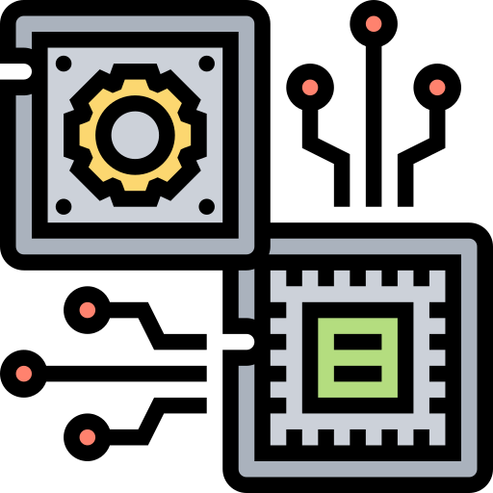
Device Architecture
IoT is not just about the small devices
Mainly includes how much data is accessed and moved around the Internet
The architecture is fundamental when handling this data
Keeping the architecture able to be scaled, changed, and available is essential; the internet is an ever changing, fast-changing, unpredictable environment
Let’s discuss the architecture parts and what they do
https://www.flaticon.com/free-icons/hardware

Slide 16
Device Architecture
Perception
-Any kind of sensors on the device to gather outside data to put to use
-Thermostat collecting temperature data to regulate house air conditioning
Network/Transport
-Data being moved, often in large amounts, from the sensors to the backend to be processed
Application
-Part of the device the user interacts with/sees
-Screens with functionality, remote controls
-Thermostat screen to indicate temperature
Processing/Middleware
-Preprosses by storing and analyzing data coming from transport
Business
-What the stakeholders decide to do with the collected data from the application
https://www.flaticon.com/free-icons/backup
https://www.flaticon.com/free-icons/performance
Architecture has five major structuring parts:

Slide 17
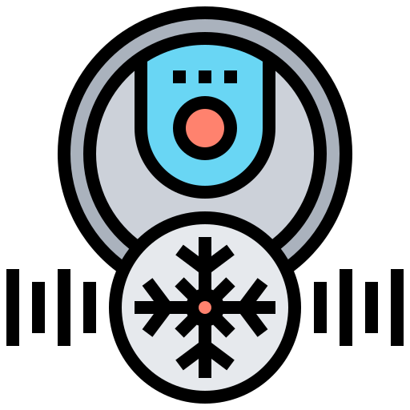
Device Architecture
Devices (Sensors and Actuators)
-Actual devices collecting and generating the data, such as a sensor or actuator.
-The physical items people will buy and use for various reasons
-Data is then digitized and transported to the next stage
Internet Gateways and Data Acquisitions
-Connected to or a part of the device
-Can also be a smaller device gaining information from the sensors and actuators
-Preprocesses data before sending it to the cloud
Edge IT Data Processing/ Fog Computing
-Data is sent to edge of cloud to be determined whether immediate action is required
-Sometimes, data is preprocessed
-Looks at recent data sent in
-Mainly used for operations that require critical time
Data Center/ Cloud
-Data is stored here to be processed by device's application and business layers
-Data can be moved here in dashboards or other forms to analyze it more in-depth
https://www.flaticon.com/free-icons/sensor
https://www.flaticon.com/free-icons/entrance
https://www.flaticon.com/free-icons/hourglass
https://www.flaticon.com/free-icons/cloud-computing
Architecture has four main stages of IoT applications:

Slide 18
Common Cyber Risks
There are three major cybersecurity risks for mobile and IoT devices:
Flawed Design
Malware
DDoS
https://www.flaticon.com/free-icons/failure
https://www.flaticon.com/free-icons/malware
https://www.flaticon.com/free-icons/ddos

Slide 19
Flawed Design
Risk Factors
Forms of Defense
Software/hardware developers make mistakes in designs of devices, which leads to vulnerabilities and allows hackers to take over:
Developers accidentally create default settings that are easy to find and use
Use the wrong/too much software, allows hackers to gain immense power when they get in
Develop the software nearly impossible to upgrade
Preventing hackers from attacking because of flawed design is up to the developers:
Avoid default settings
Use correct software, and not too much
Assure software can be updated
Consumers can prevent attacks by researching devices they are buying and decide the risk they hold:
Review the release date of device and if it has been updated
Check reviews on device to see any previous issues

Slide 20
Flawed Design
Developer
Default Settings
Device
Flawed Design!
Wrong Software
https://www.flaticon.com/free-icons/programmer
https://www.flaticon.com/free-icons/food-processor
Impossible to Upgrade

Slide 21
Malware
Risk Factors
Forms of Defense
All harmful software, takes many forms:
Ransomware: attackers encrypt data and charge a ransom to return it
Phishing: a message (email, text, etc) to get user to click a link, download, or share information, allows access to device
Trojan: disguised as legitimate software/files, deceives users into downloading/executing on systems. Perform various harmful actions:
Stealing sensitive information
Compromising system security
Providing unauthorized access to the infected system
Securing against malware also takes many forms:
Strong, protected passwords with two-factor authentication
Able to recognize phishing attempts,
Don’t download/share information with untrusted sites
Update devices and applications
Antivirus software, adds extra protection
Remove malware by:
Shutting off Wifi
Running malware scanners
Closing suspicious apps and links
Resetting device to manufacturer settings

Slide 22
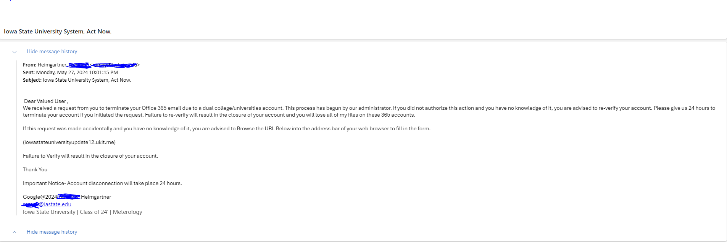
Malware Activity
Spot the signs that this might be a phishing scam!
User had no prior knowledge of this termination, and did not have a dual college account.
Urgency, saying user has to act now. Meant to scare user into acting too fast to think
Universal language
Unauthorized website
Mistakes in spelling/grammar
Repetition of the urgency
This email is a scam but a very real one. It is important to recognize the signs of a phishing scam to prevent giving personal information to hackers.
Clearly student info, not a faculty member

Slide 23
DDoS
Risk Factors
Forms of Defense
Distributed Denial of Service:
Attacks flood device's operations and render it unusable
Send signals from bogus sources to create traffic in device system, making it difficult to track where attack originated
Attacks the connection rather than the device itself
Imagine a person receiving so many phone calls at once that they can’t use their phone, and they must go through their provider to block all the calls
These attacks usually are solved at the corporate level and can’t be prevented by device user
Adding extra security layers to a device that has been created and is available to receive
Customers must rely on device's company to get them functional again and input necessary security measures to prevent attacks

Slide 24
So How Do We Protect Our Devices?
It is difficult for consumers to prevent security breaches on their IoT devices, and most of the time we must rely on the manufacturers
Antivirus services, authentication, and strong passwords are good starts for mobile devices
BEST PRACTICE IS BEING AWARE!
What devices are secured by the manufacturer?
What are any breaches or attempted breaches on the product?

Slide 25
Security Measures Used
Secure Boot
-Ensure that the device only uses software the original equipment manufacturer trusts
-Uses cryptographic code
Secure Firmware Update
Similarly to the secure boot, this ensures the updates for the device are firmware that the OEM trusts
Secure Communication
-Adds protection to data in motion to prevent data going into the clear where it can be intercepted by hackers
-Prevents leaks of passwords or confidential information
-Transport Layer Security (TLS) encrypts email messages
-Datagram Transport Layer Security (DTLS) secures datagram-based communications
-IPSec sets up secure connections over a network

Slide 26
Security Measures Used
Data Protection
-Encryption of all sensitive data stored in a device
-Helps if a device is discarded or stolen so data cannot be quickly recovered
User Authentication
-Two-Factor Authentication is an example: a user must verify that they are attempting to sign into or use data from a device to add an extra layer of protection
-This is extremely important as password leaks are common

Slide 27
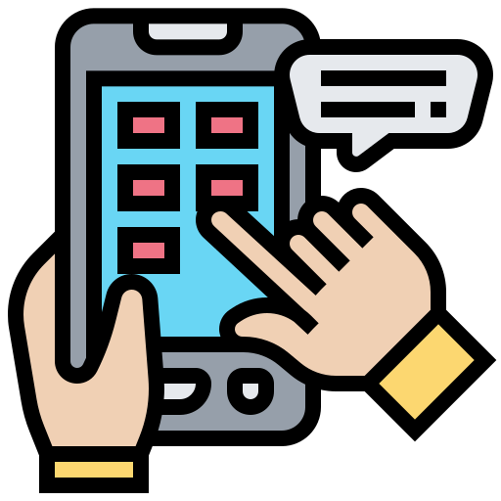
Mobile Safety
https://www.flaticon.com/free-icons/application
Financial Transactions, App Downloading, and Privacy Sharing

Slide 28
Safety in Mobile Financial Transactions
Banking on mobile devices has become more and more common
Knowing how to stay safe and protect your information is important
Phishing attempts
False Payments
Other Hacks
Fake messages from bank, emails with hidden links, fake apps with false log in screens, or pop ups on the internet
Fake checks, or emails asking for money
Hacking through Wifi networks to having phone stolen
-Verify any alerts or messages that appear to come from bank
-Look out for suspicious emails
-Check app details before downloading -Never download/click a link/fill out information that is not confirmed to be secure
-Avoid receiving checks as payment from untrusted sources
-Take check directly to bank to verify that it is real
-Never send a payment without direct confirmation from the person asking for it
-Use secure Wi-Fi networks and Two Factor Authentication on all passwords
-Installing Anti-virus is another good way to prevent hacking

Slide 29
Already Hacked?
If all else fails, and you find yourself suspicious of a hack:
Tell your bank immediately.
Freeze any and all accounts, cards, and credit
Check account for unverified purchases
Run antivirus scan
Delete any suspicious apps
https://www.flaticon.com/free-icons/fraud

Slide 30
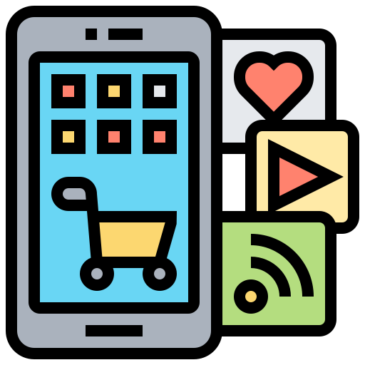
Downloading Apps
Safe stores like Apple App Store and Google Play Store are more likely to be safe and secure
Apps that contain too little/too much data are probably fake
60MB for Android and 174MB for Apple are the average sizes
Check reviews and downloads
Terrible reviews/very few reviews and very few downloads = less likely to be legit.
Any that indicate the app might be fake
Look at app description for mistakes
Descriptions with social media links are more likely to be legitimate if they come from a legitimate company
Look at app updates
Very few: more likely to be outdated and unsafe
Persistent updates: can be an attempt to look natural
Unrealistic subscriptions, permissions, and promises
Check if the published date makes sense
If app seems older and was only recently published, might be fake.
https://www.flaticon.com/free-icons/apps

Slide 31
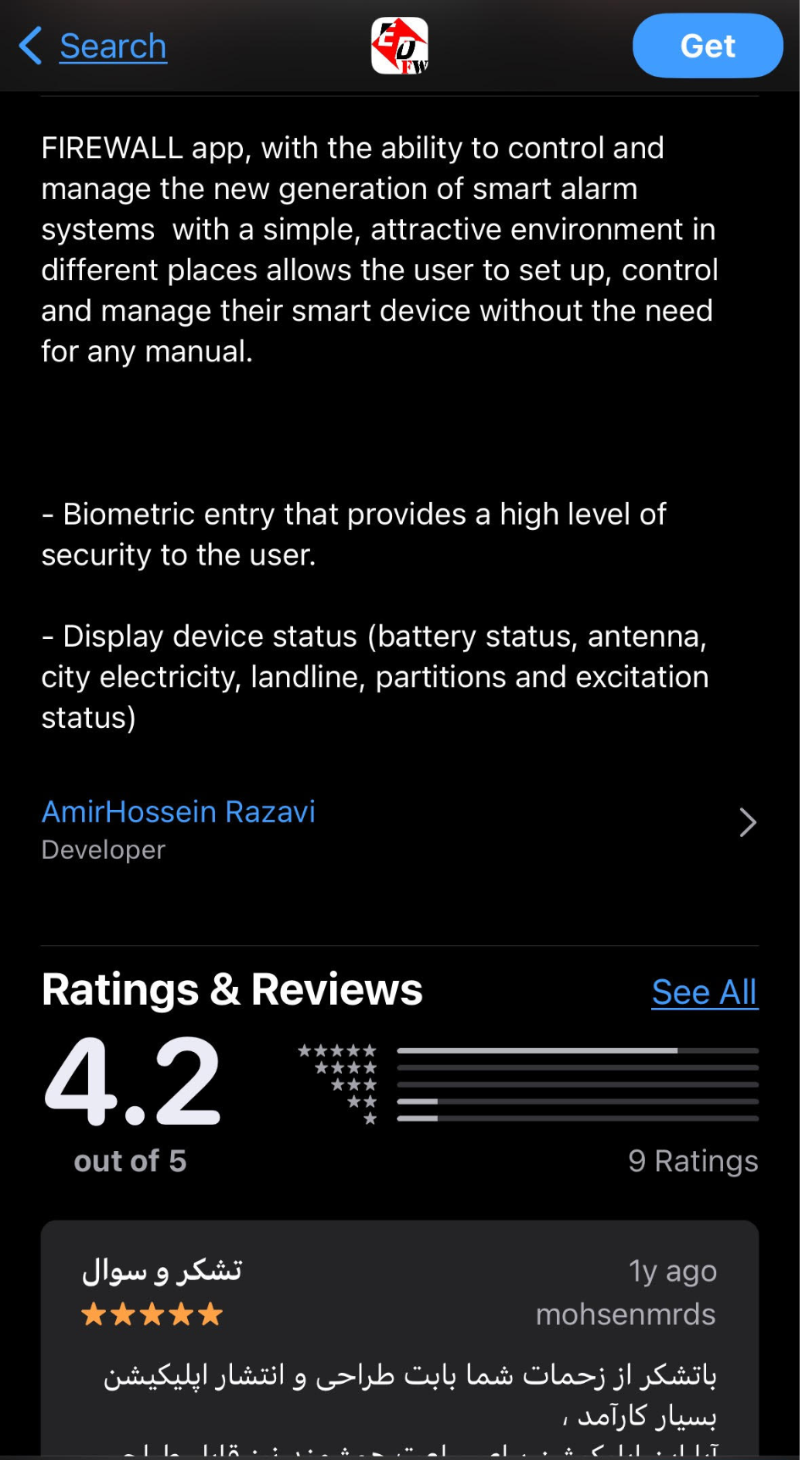
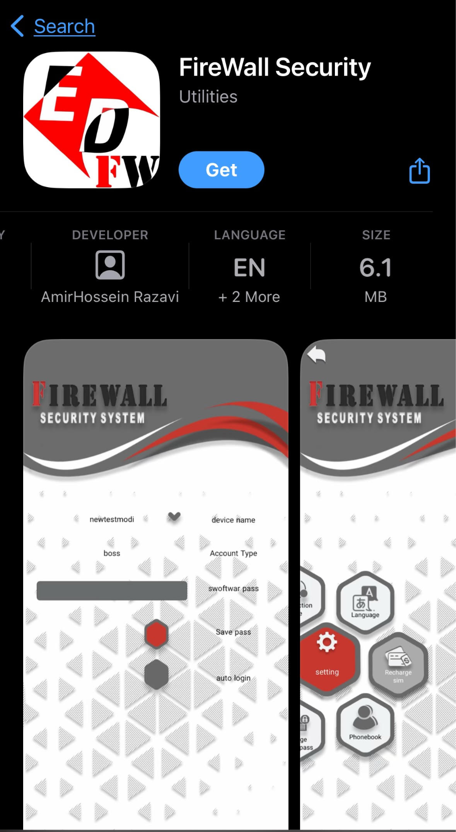
Activity 1: What are the red flags on this app?
Very low app size!
Few Ratings!
No recent updates
(Only two updates total!)
While the app is not verified to be fake, it has a lot of indicators to avoid downloading it.

Slide 32
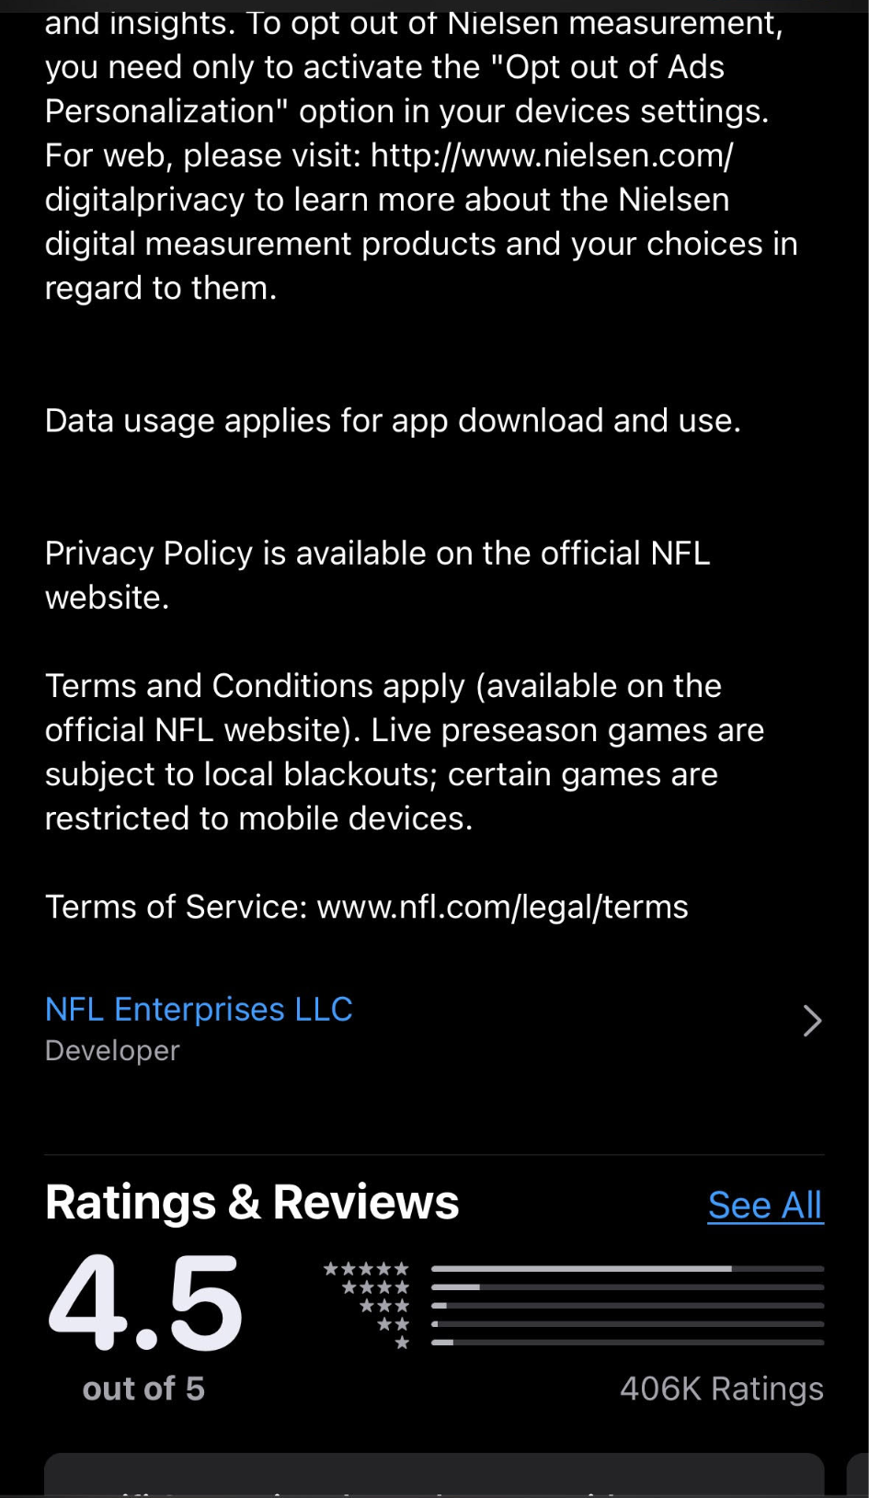
Activity 2: What are the green flags for this app?
Description has no errors, includes links for official NFL websites
Size is within range
Release date is reasonable
Seller is well known
Lots of ratings with good reviews
Up to date
(Has 25 total version updates, not too much or too little)
Overall this app looks safe!

Slide 33
App Permissions
Location
Health and Fitness
Messages
Developer Communication
What?
Files and Docs
App Activity
Account Management
Fraud Protection, security, compliance
Personal Information
Personalization
Web Browsing
Calendar
App Functionality
Contacts
Device or other IDs
Audio Files
Advertising or Marketing
Why?
Financial Info
Photos and Videos
Info and Performance
Analytics
What they are and what to know

Slide 34
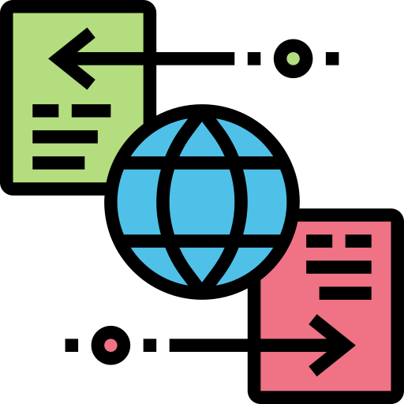
What Should Be Shared?
Apps ask for certain user data for a variety of reasons
Data like location is used for GPS apps, while user activity is used to create ads aimed at the users’ interests
PAY ATTENTION to what kind of data is being asked for
Look at privacy policies to see what is shared and how it is being used
If an app is asking for too much or unreasonable data, it could be fake
To manage your app permissions, go to settings on your device and find the app settings, or find the internal app settings and change it there
When allowing data usage, think about why that app might want to use this data, and if it is actually necessary to provide it
A pizza store app might ask for location to help with pizza deliveries, but also provide an option to just input an address
In this case, allowing them to access your location is not necessary for the app to function
https://www.flaticon.com/free-icons/data-transfer

Slide 35
Activity 3: Why does Tik Tok want to access these types of data, and is it necessary to share it?
1: Used to find other people the user might know that are on the app.
NOT NECESSARY: looking up usernames and people is also an option
1
2: Used to create slideshows with pictures from camera roll, update profile picture
NOT NECESSARY unless performing those actions
2
3
3: Microphone access to record videos
NOT NECESSARY unless performing that action
4
5
4: Camera access to record videos, read face for filters
NOT NECESSARY unless performing those actions
6
5: Allows user to access music and other media from other apps to use for videos
NOT NECESSARY unless performing those actions
6: Allows Siri and iPhone to make suggestions with Tik Tok and its content
NOT NECESSARY

Slide 36
Stay Safe!

Slide 37
Sources + Additional Readings
What Is IoT Architecture? Guide And Examples | MongoDB
Has great diagrams and a lot of information on the architecture of IoT devices
23 IoT Devices Connecting the World | Built In
Includes examples of IoT devices
What Is IoT Cybersecurity | CompTIA
Cyber attacks on IoT devices, some good charts. Explains the different parts of these devices and how they can be attacked.
What Is a DDoS Attack and How Does It Work | Cybersecurity | CompTIA
Good details on DDoS attacks
What Is Malware - How to Prevent and Remove It | Cybersecurity | CompTIA
Information on malware and other attacks
How to Protect Connected Home Devices and Appliances from Cyber Attacks - IoT Security Foundation.
Protecting IoT devices
A Guide to the 12 Most Common IoT Protocols & Standards
Standard security measures
The Risks of Mobile Banking Apps: Keep Your Money Safe
Mobile banking risks and safety measures
Has great integrated links for other information
How To Spot Fake Apps: App Size, Permissions, Source
App security
What are fake apps? How to identify and avoid fake apps
App safety
Understand app privacy & security practices with Google Play's Data safety section - Android
App permissions

