Slide 1
Phishing Attacks
Securing the Future, One Ambassador at a Time.
www.iowacyberhub.org/ambassadors

Slide 2
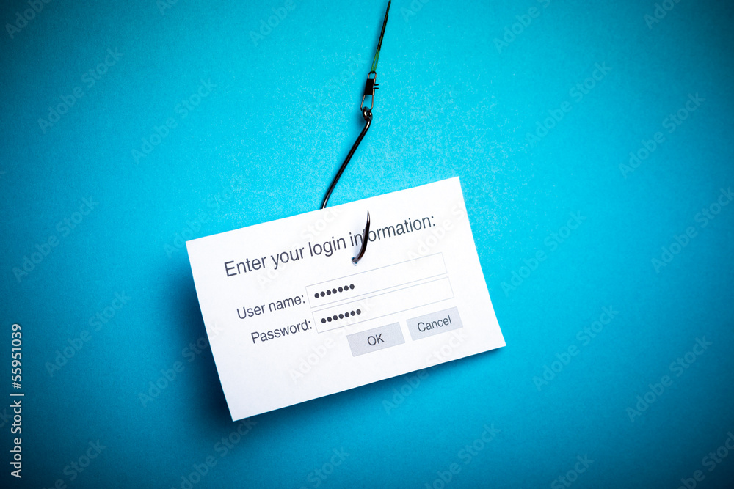
What is Phishing?
Phishing is a cyberattack that uses fraudulent emails, calls, texts, or other forms of communication to get people to give sensitive data, download malware onto their device, or other devious activities.
Phishers send out “bait” to potential victims waiting for them to bite and be tricked.
It is a form of social engineering, essentially manipulating people.
Dangerous and hard to prevent because it abuses human error rather than a computer/networks weaknesses.
Emails will come from spoofed addresses/numbers that appear legit but aren’t.

Slide 3
What Does Phishing Look Like and Why Should You Care?
Often a phisher will pretend to be company and will send an email with either a link or attachment that contains malware.
Extremely easy and effective way for a hacker to infiltrate a system given they need to trick a human and not outsmart a computer system.
Can lead to credit card theft, identity theft, monetary theft, extortion, account sabotage, and more.
Common for employee’s to be targets of phishing in order to compromise a company’s sensitive data.
There are many types of phishing that vary from emails to calls to QR codes. With so many ways it’s important to be aware and updated on the latest phishing trends.
According to Cisco's Think Before You Click 94% of malware on computers is a result of a phishing attack.

Slide 4
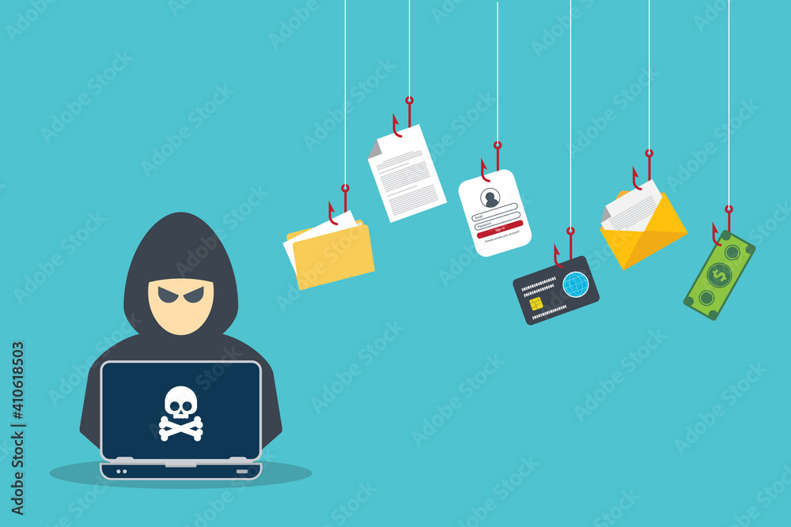
Bulk Phishing
Send phishing attempts to many random individuals with the hope that a fraction of the individuals will fall victim. No specific target.
Normally through email and create a sense of urgency to provoke strong emotions.
The attacker will go through great lengths to make the emails appear legit.
Align with holidays and trends such as on amazon prime day when phishers will send amazon related attempts.

Slide 5
Spear Phishing & Whaling
Spear phishing is for a specific target person or organization normally with a specific intent or reason such as a targeting a finance manager who has access to move money from accounts.
Phishers will often study their target before making a move. Such as finding out who their friends or boss is so they can spoof their email.
Contains specific information to appear more legit.
Whaling is spear phishing but for a “big target” such as a CEO. Specially crafted emails with as much information as possible to seem real.

Slide 6
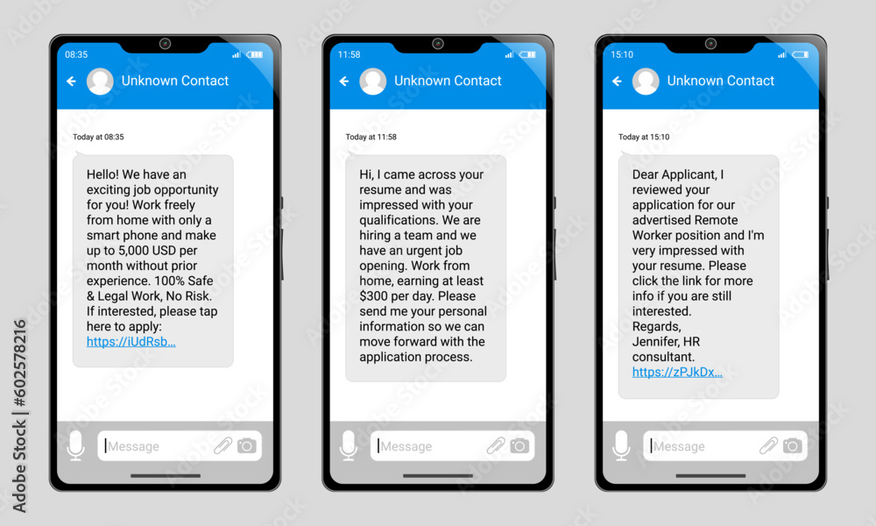
Smishing
Phishing through text, also known as SMS.
One common example is a phisher posing as the US postal service saying a fee is required to pickup a package.
Phishers will spoof phone numbers to seem legit.
Often contain links to websites that will install malware.

Slide 7
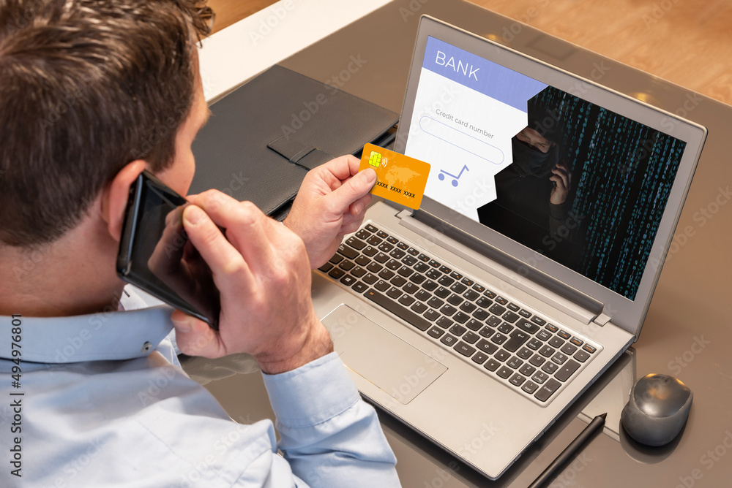
Vishing
Phishing over voice or phone calls.
According to APWG, there was a 260% increase between 2022 and 2023 in vishing attempts.
Voiceover tech has made this easier than ever.
Phishers can now make millions of calls per day with current technology.
Common examples of vishing attempts are about credit card problems, overdue payments, and legal issues.

Slide 8
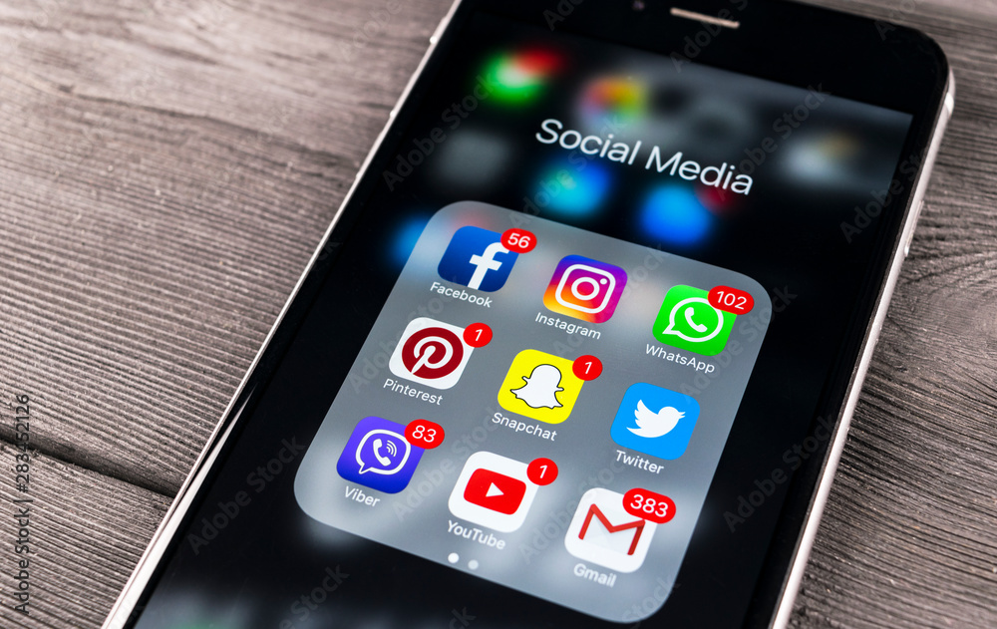
Angler Phishing
Phishing through social media such as X, LinkedIn, Facebook, Insta, and other social media platforms with DM’s.
Common trends include posing as users who need the targets help to log into their account. Another common way is tricking victims into thinking they won a prize.
NEVER click links from unknown senders and beware of links from friends as their account could be compromised.

Slide 9
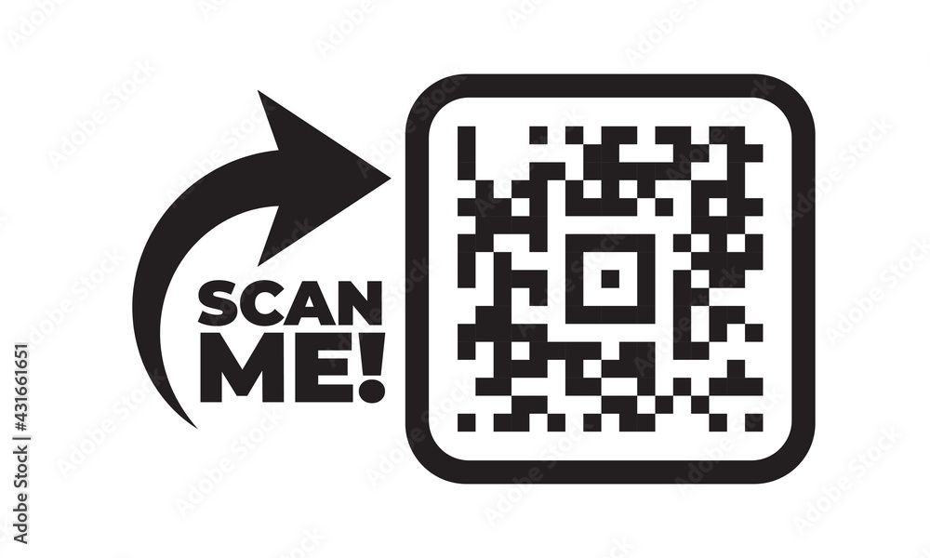
Quishing
Phishers will put up QR codes in emails, texts, and even just posted in public that will take the victim to a website that will infect their device with malware.
Effected method in city areas such as subways where QR codes can be placed over the real ones, making it look legit but in reality, a phisher put theirs over the real one.

Slide 10
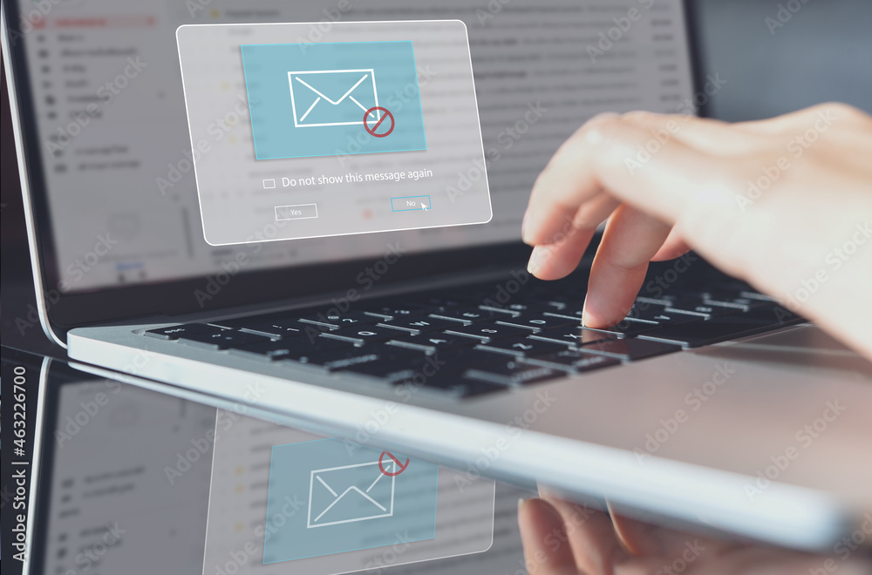
Business Email Compromise (BEC) Attacks
When a cybercriminal attempts to steal money or sensitive information from a business.
BEC attacks stole more than USD 100 million from Facebook and google posing as a legitimate software vendor. (Additional reading: Here)
2 Common types:
CEO Fraud
An executive's email account will be hijacked.
Using this email access the hacker will send out emails to lower-level members of the company ordering them to buy something or transfer money, and because it came from an executive they will most likely listen.
Email Account Compromise (EAC)
Compromise a lower-level employee’s email account such as a account manager in finance, sales, etc.
Send fraudulent emails/invoices to vendors and instruct employees to make fraudulent payments or request sensitive data.

Slide 11
Clintons 2016 Election Phishing Attack
One well known Phishing attack occurred during the 2016 US presidential election, and Hillary Clinton was the victim of this attack.
Russian hackers sent emails spoofed to look like they were from google, asking for members of Hillary’s team to boost security and change passwords but in reality, the emails directed them toward decoy websites that stole information.
Clinton's campaign was not an easy target, as they actually put lots of stress on digital safety. Even a top-notch group can fall victim to phishing.
Additional reading can be found here. (Check the link first, it's good practice!)

Slide 12
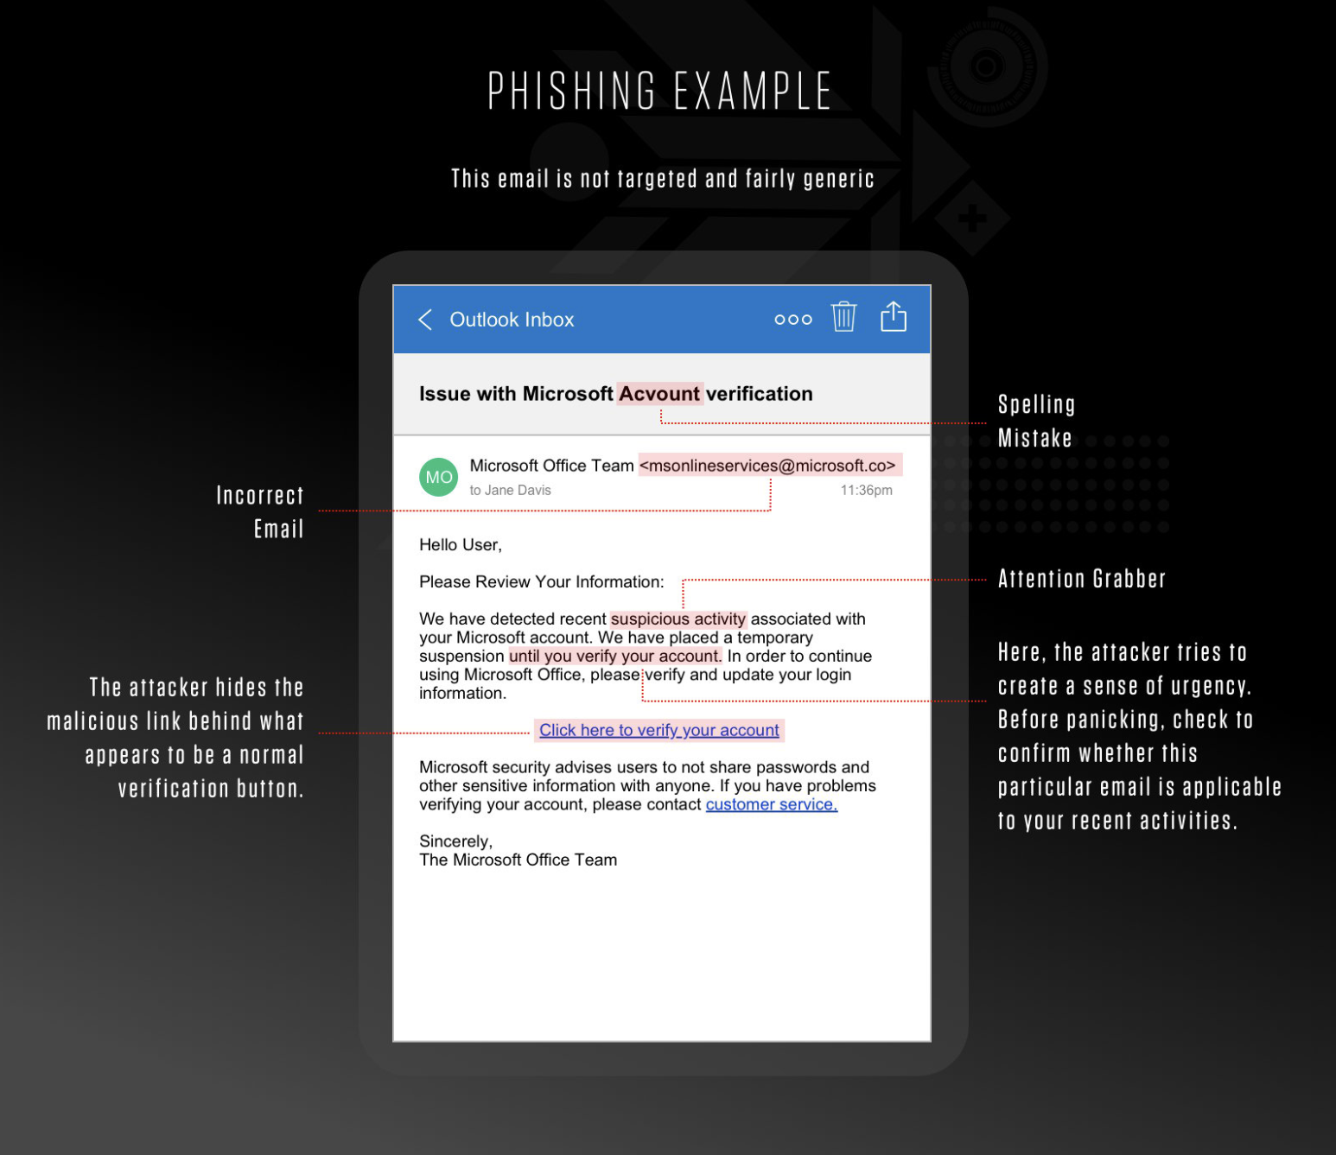
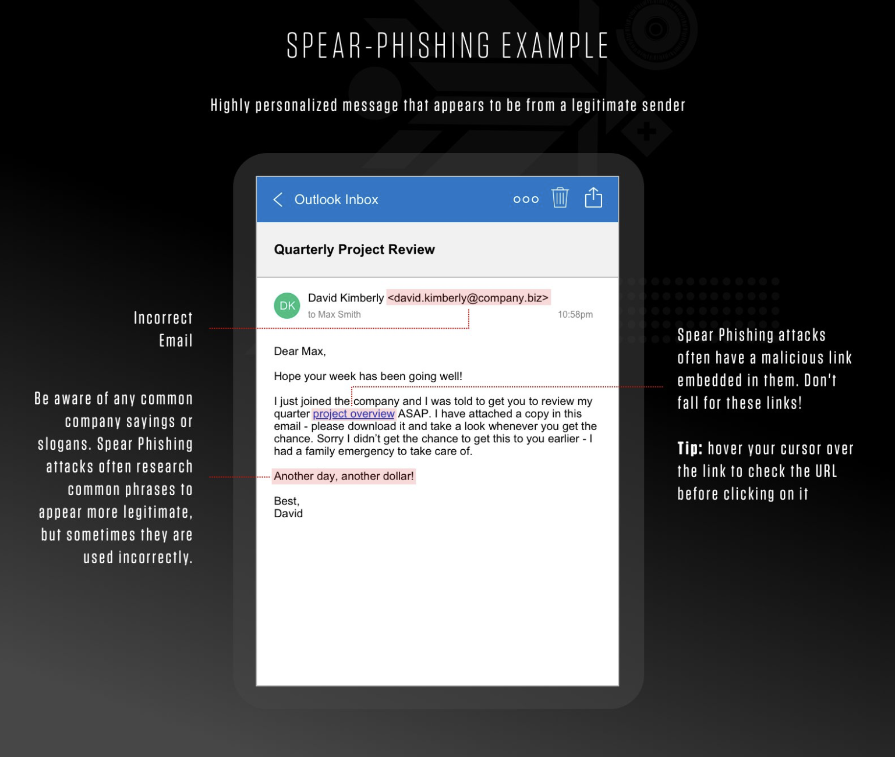
Bulk Phishing vs Spear Phishing
Credit: https://www.crowdstrike.com/cybersecurity-101/phishing/spear-phishing/

Slide 13
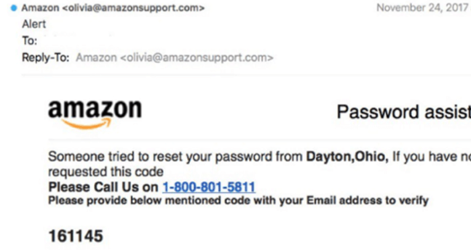
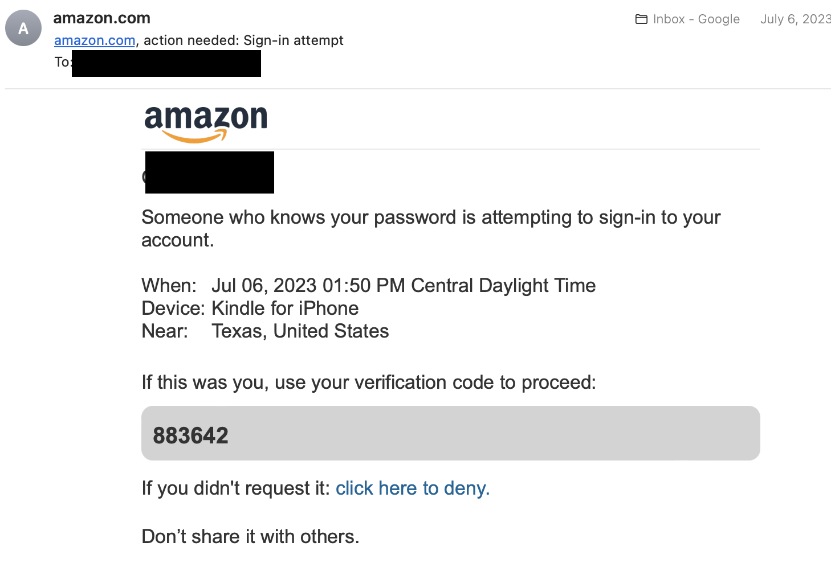
Which is legit?
Credit : https://www.itgovernance.eu/blog/en/the-5-most-common-types-of-phishing-attack

Slide 14
Which is legit?
Credit : https://www.itgovernance.eu/blog/en/the-5-most-common-types-of-phishing-attack
The emails look very similar, but don’t be fooled, the one on the left is a Phishing attempt. Olivia@amazonsupport.com is an email that contains Amazon in it, but it is not legitimate. It can be VERY tricky!

Slide 15
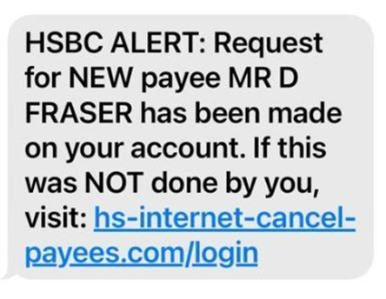
Smishing Examples
Credit: https://www.proofpoint.com/us/threat-reference/smishing
This example uses fear to get the victim to call the number which is where vishing will take place. This is a hybrid example with smishing and vishing.
The example above is a very common smishing example from someone impersonating FEDEX , USPS, UPS or another package delivery company.
The link on this example leads to a malicious website. Always check links legitimacy before opening!

Slide 16
How to Prevent Phishing
Do not click on links in emails unless its 100% secure!
Keep software updated, hackers rely on old software with holes in it to do their damage.
Get an email security program that filters out common phishing scams.
Use your brain! Is it too good to be true? If the answer is yes, then it is probably a phishing attempt.
Monitor your online accounts regularly.
Don’t give out personal info over email.
Keep an eye out for emotional lures, such as urgency or ridiculous allegations in emails, calls and texts.
Avoid responding to texts and calls from random numbers.
Look out for poor spelling and inconsistent grammar in emails, Aswell as very vague statements such as “Your account has been compromised”.
Always check the email sender. EX: admin@microsoft.com vs admin@rnicrosoft.com.
There is no way to train and recognize every single phishing attempt out there, so it is important to always be aware as they continue to evolve.

Slide 17
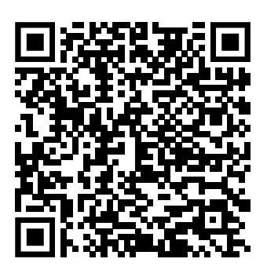
Thank You for Your Time! Please fill out the survey on the QR code!
Citations
https://www.ibm.com/topics/phishing
https://www.cisco.com/c/en/us/products/security/email-security/what-is-phishing.html#~phishing-attacks
https://www.cisco.com/c/dam/en_us/about/doing_business/trust-center/docs/phishing-program-infographic.pdf
https://www.ncsc.gov.uk/guidance/phishing
https://www.cnbc.com/2019/03/27/phishing-email-scam-stole-100-million-from-facebook-and-google.html
https://www.itgovernance.eu/blog/en/the-5-most-common-types-of-phishing-attack
https://www.proofpoint.com/us/threat-reference/smishing
https://www.crowdstrike.com/cybersecurity-101/phishing/spear-phishing/
https://stock.adobe.com/

